Slide 1
Working with Clients with Serious Mental Illness to Improve Health Outcomes Workshop
November 14, 2019

Slide 2
Welcome from Better Health Together
Sarah Bollig Dorn
Senior Program Manager

Slide 3
AIMS Center Introductions
John Kern, MD
Clinical Professor
Milena Stott, LICSW, CMHS, CDP
Clinician Trainer

Slide 4
Introductions from Teams
Clinic team
Name
What is your role?
What is one thing you are hoping to gain from this training?

Slide 5
Setting the Stage
Housekeeping
Handouts and slides
Action planning worksheet
Evaluation
Notes:
Housekeeping- Bathrooms, food, water
High level review- Quick review of agenda and packets

Slide 6
Overview of the Day

Slide 7
Team Approaches to Supporting Health Outcomes in a Behavioral Health Agency
Session 1

Slide 8
Learning Objectives
By the end of this session, participants should be able to:
Describe evidence and causes for reduced life expectancy in SMI populations
Explain rationale for mental health providers accepting responsibility for improving health outcomes
Illustrate the structure of an integrated care team, and the functions its members carry out
Notes:
Key Message(s):

Slide 9
What Motivates Us?
Mission
Desire to take better care of individuals
What’s your story?
Financial sustainability
ACH payment
Eventual Value-Based Payment
Meeting payment metrics
Other Reasons
Notes:
Key Message(s):

Slide 10
Introduction to the Mortality Gap
Hard to pursue recovery goals when dead
No one else is doing it
Opportunity for frequent touches
Now part of our mission
Notes:
Key Message(s):

Slide 11
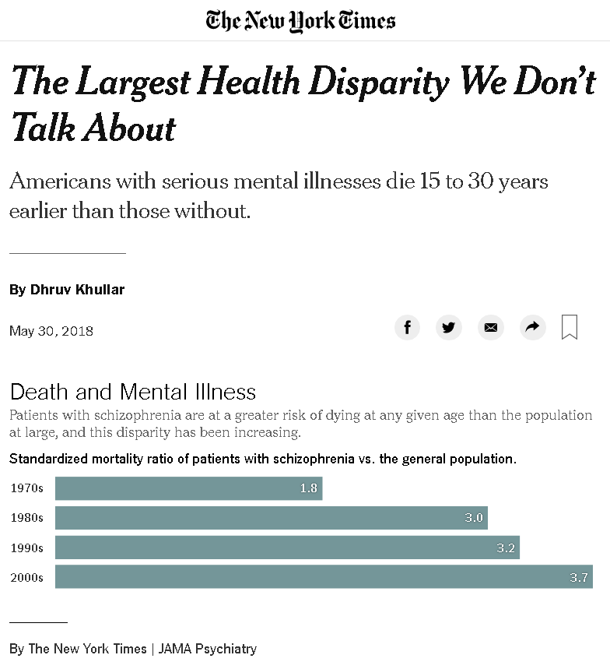
Reflection & Discussion
After reading the New York Times article….
Any immediate reactions?
How might you respond?
Notes:
Key Message(s):
Bring just for presenters?

Slide 12
Life Expectancy of People with Symptoms of SMI: Still Short and Still Not Improving
Bar 1 & 2: Druss BG, Zhao L, Von Esenwein S, Morrato EH, Marcus SC. Understanding excess mortality in persons with mental illness: 17-year follow up of a nationally representative US survey. Med Care. 2011 June;49(6):599-604; Bar 3: Daumit GL, Anthony CB, Ford DE, Fahey M, Skinner EA, Lehman AF, Hwang W, Steinwachs DM. Pattern of mortality in a sample of Maryland residents with severe mental illness. Psychiatry Res. 2010 Apr 30;176(2-3):242-5
Notes:
Key Message(s):
In spite of 10 years of efforts, the decreased life expectancy of those with serious mental illness has not improved at all. The actual implementation of team-based efforts like the ones we are working on has been rather rare.

Slide 13
Cardiovascular Disease Defined
Blocks blood vessels to heart or brain
Causes heart attack or stroke
Notes:
Key Message(s):
Whether we talk about “whole health” or “reverse integration” or “primary care in behavioral health”, the primary target should be the early death and disability of our clientele with serious mental illness [or increasingly, children with serious emotional disturbance], and the primary cause is cardiovascular disease. But what is it?
Condition in which plaque sticks to the arteries and builds up – and can eventually cause a heart attack (if arteries to your heart gets blocked off) or stroke (if the arteries to your brain gets blocked off).
This is the number 1 health condition that is killing folks with SMI.
The conditions we will talk about managing all are important because they hasten this process.

Slide 14
Prevalence of Current Smoking
Any Psychiatric Illness
Dickerson F, et.al,. Psychiatr Serv 2013; 64 (1): 44
Notes:
Key Message(s):
Though the smoking prevalence has been cut in half nationally… nothing has changed for those with smi.
Chart depicts the national prevalence for no psychiatric illness around 20%, any psychiatric illness closer to 38 –
and if we get really specific we see a smoking prevalence of over 40% in those diagnosed with bipolar disorder, and over 60% for those diagnosed with Schizophrenia.
This goes to show – there is still work to do!

Slide 15
Small Changes Big Difference
Cholesterol
↓10%
10% ↓ in cardiovascular disease
Blood Pressure
↓6mm/Hg
16% ↓ in cardiovascular disease
42% ↓ in stroke
5% ↓ in cardiovascular disease
Triglycerides
↓10 mm/L
21% ↓ in diabetes related deaths
14% ↓ in heart attacks
37% ↓ in microvascular complications
HbA1c
↓1 pt
Notes:
Key Message(s):
But there is hope, there is good news – making small changes have a huge impact.
Decreasing cholesterol by 10% -> reducing the risk of cardiovascular disease by 10%
Decreasing blood pressure by 6mm/hg -> reduces the risk of cardiovascular disease by 16% and the risk of stroke by 42%!!!!!
We will talk about simple interventions using evidence based treatments, like medications, to decrease mortality risk in our patients… there is hope!

Slide 16
Principles for Evidence-Based Integration
Team-Based and Person-Centered
Primary care and behavioral health providers collaborate effectively, using shared care plans.
Population-Based and Data-Driven
A defined group of patients or clients is tracked in a registry so that no one “falls through the cracks.”
Measurement-Based Treatment to Target
Treatment goals clearly defined and tracked for every patient. Treatments actively changed until clinical goals are achieved.
Notes:
Key Message(s):
Principles the same no matter how you define your model, which
Team-based
Population-based focus
Measurement-based treatment to target

Slide 17
Measurement-Based Care
Systematic use of clinical data to drive clinical decision making
Notes:
Key Message(s):
The lessons learned from integration of BH into PC are that things not measured tend not to improve.

Slide 18
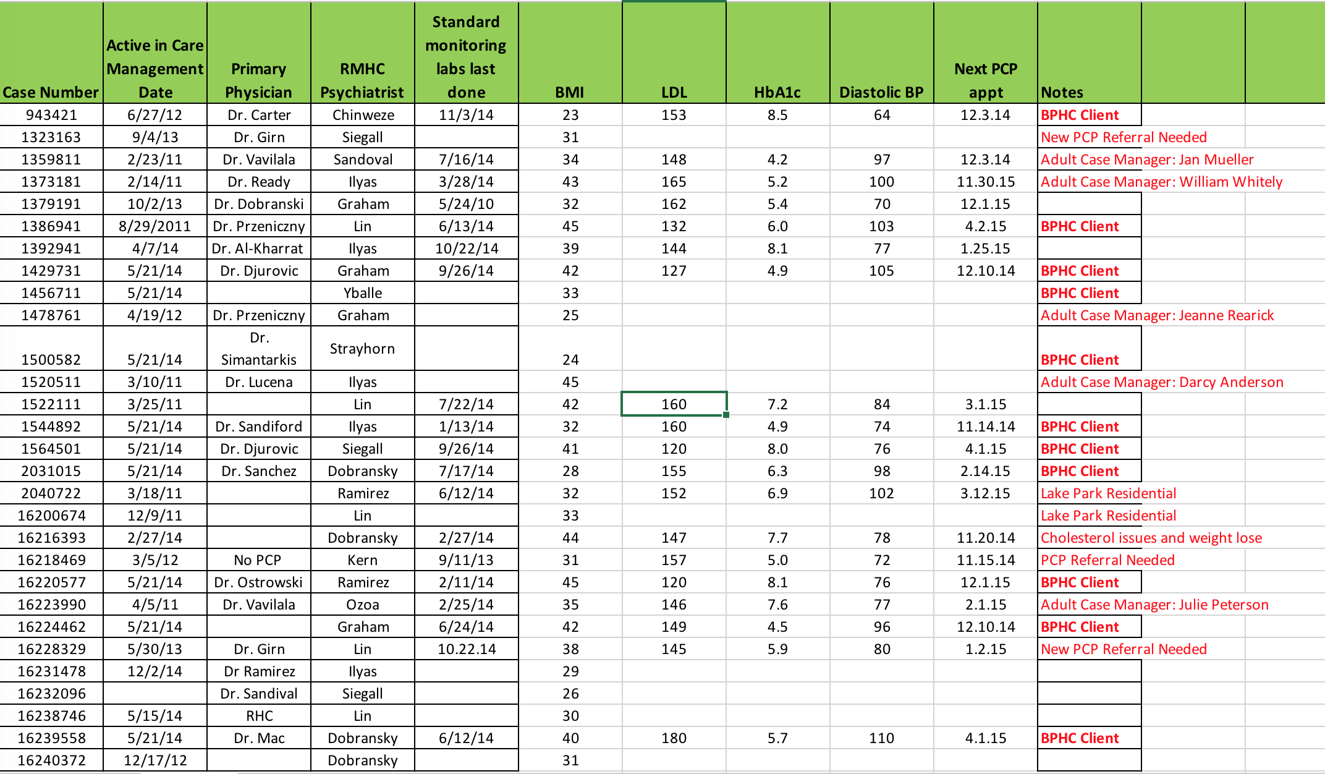
Use of a Registry Supports Measurement-Based Care
Notes:
Key Message(s):
A registry is a tool that makes it easy for us to follow our measurements and act on them and see if this is getting people better.
Everything else about what it looks like or how you make it is commentary,

Slide 19
Behavioral Health Home
Nurse Care Manager or Other Care Manager
Case Manager
Mental Health Center
Medical Consultant / Psych Provider
Behavioral Health Agency
Patient
PCP
PCP
Primary Care
Primary Care
Notes:
Key Message(s):
An approach to supporting the health of our clients that has been the most effective looks like this: team based and client centered.
The idea is that there is a team – that patients (in purple) need another layer of support to effectively interact with their PCP.
In this diagram, there is a nurse care manager AND someone fulfilling case management functions (circled in red). This is the person doing a majority of the hands-on face to face relationship building with the client.
We want to note that not all agencies have a case manager per se, some might use a peer support specialist, therapist, patient navigator or care coordinator in this role
In the next slide we’ll describe the type of functions that someone in this role fulfills -

Slide 20
Care Functions
Screening Functions
Psychiatric Provider Functions
Case Management Functions
Registry Functions
Medical Consultant Functions
PCP Functions
Notes:
Key Message(s):
So one way to think about the process of monitoring and supporting physical wellness is as a series of functions, which usually are provided by, for example, the psychiatrist, but in order to actually be performed, need to be moved around to other staff, depending on the particulars of the agency.

Slide 21
New Ways to Perform Tasks
Changing roles of existing staff
OP nurses expanding into population health
Case managers expanding role definition into physical health.
Peers
Primary role in supporting good health behaviors
Support staff
Clerical support of registry function
Have you figured out a novel solution?
Notes:
Key Message(s):
Here is a great way to bring in some of the examples we have been learning about in their region and also from North Central
There is any number of ways that behavioral health organizations have changed to address these issues:
OP psychiatry nurses who were essentially hired to provide clinic support, give shots, etc, expanded their scope to provide support to the process of primary care, for example becoming the driver of the registry and organizing the efforts of case managers in the field.
Case managers who saw their support of SMI clients as not including attention to medical issues were able expand their knowledge and effectiveness in this area with training and support.
Peers in some organizations have taken on as their primary role support of individuals working on health behavior change, for example smoking cessation or exercise programs.
In some organizations, clerical staff have taken on work with the registry, entering data or preparing reports for the team to use to organize their work.

Slide 22
Action Planning
Notes:
Length: 2 minutes
Key Message(s):
After each session write down ideas, inspirations, or other things you want to take back to your organization to shape your work.
In this case it could be: thinking about your team structure, roles and functions fulfilled by those roles

Slide 23
Partnering with Primary Care
Session 2
Notes:
The most important tasks in supporting the physical health of people with SMI have to do with interactions with the health system, which is bewildering for the best of us.
The place that this usually happens is the primary care office.
Getting skillful at managing interaction with the primary care office, and helping your clients to develop these skills, pays dividends in your client’s health.

Slide 24
Learning Objectives
By the end of this session, participants should be able to:
Familiarize behavioral health agency staff with the medical office setting
Describe steps to build relationships with primary care providers and teams
Describe cultural differences between behavioral health and primary care
Notes:
Key Message(s):

Slide 25
Bridging the Cultural Divide
Behavioral Health
Primary Care
Notes:
Key Message(s):
It is hard to overemphasize how differently care is provided, and the work is viewed in our two different sites. Learning how primary care staff see the world and their work priorities is a good first step to working productively with them.
Similarly, they will usually see our clientele and the work we do as odd, strange, and maybe scary. Knowing this, you may be able to assist them in getting comfortable with you and your clients.

Slide 26
Primary Care Provider's View
I don’t understand patients with mental illness
Their physical illness and symptoms are due to mental illness
Treating people with mental illness takes more time
Notes:
Key Message(s):
These are direct quotes from primary care providers we have worked with.

Slide 27
Client’s View
Doctors don’t understand
Doctors are incompetent
Doctors are impatient
Doctors are scary
Notes:
Key Message(s):
Little wonder clients aren’t enthusiastic about interacting with primary care!

Slide 28
Cultural Differences
Pace
Environment
Model of Care
Jargon
Notes:
~ Concept set up slide – should be brief~
Key Message(s):
The primary care and behavioral health environments are characterized by differences in culture .
This is often a difficult gap for many to try and merge.
PCPs may notice some of these differences when they work in behavioral health environments
In the next several slides we will discuss the following cultural differences between primary Care and behavioral health
Important to understand these differences so that we are able to better work together

Slide 29
Pace
May be long wait in waiting room
Appointment may be delayed
Initial encounter with provider 15-30 minutes
Follow up encounter 7-20 minutes
Same day appointments possible
Only possible to address top 1-3 concerns, at most, in any given appointment
Notes:
Key Message(s):
Things move quickly, though it may not seem so in the waiting room.
The necessity of focusing on only a subset of one’s problems, after going to all the trouble to get there, can be very frustrating, but this is a parameter you have to learn to work within.

Slide 30
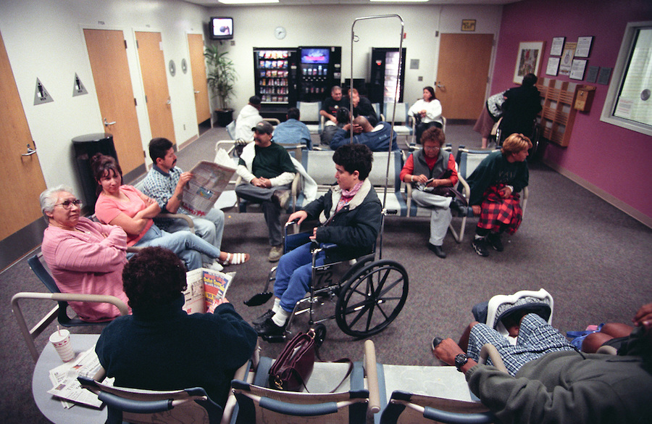
Environment of Primary Care
Busy, hectic, full waiting room
Notes:
Key Message(s):
Some people find the other patients, with all their illnesses and paraphenalia, scary and even disgusting.
Some PC staff find our patients unsightly and disruptive. Think about helping your clients to be good waiting room citizens – it is easier when you know the clinic’s particular routine.

Slide 31
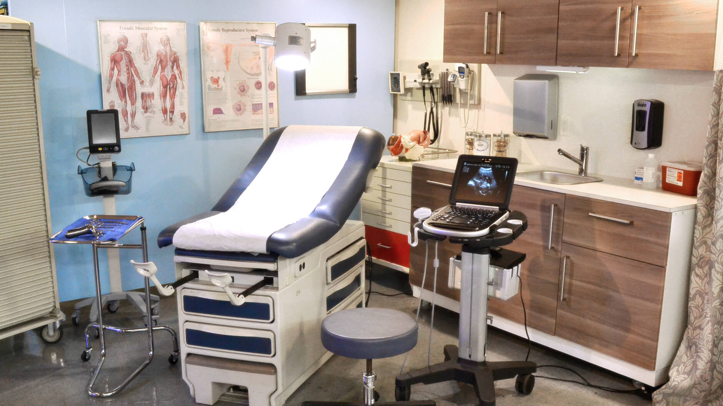
Environment of Primary Care
Exam rooms with lots of gadgets
Notes:
Key Message(s):
Again, lots of things that might poke you, and scary drawings on the wall. Modeling for your clients a calm approach can be helpful.

Slide 32
Primary Care Visits Different from the Mental Health Environment
Usually interact with several people before seeing PCP:
MA, Care Coordinator, LPN, RN, ARNP, Care managers….
Frequent interruptions
Services involve touch
Address top 1-3 concerns
Notes:
Key Message(s):

Slide 33
Primary Care Jargon
“Patient” vs. “client” or “consumer”
“Member” in a health plan
Medical jargon (BP, BMI, HTN, DB, HGBA1C, etc.)
Notes:
Key Message(s):

Slide 34
Reflection & Discussion
What are your tips for developing a relationship with primary care?
What have you tried that worked? Didn’t work?
Notes:
Key Message(s):

Slide 35
Partnership Principles: Do!
Tend to their needs
Bring something to the table
Assist whenever possible
Make it about the next 10 encounters
Find common ground and interest
Reveal anything helpful
Take one for the team
Notes:
Key Message(s):
You will likely have many interactions with a given PCP office.
There are some useful strategies for building a healthy and productive relationship.
Think of playing the long game, paradoxically this means doing more for your partner than for yourself in the beginning..

Slide 36
Partnership Principles: Don’t!
Bring your needs first
Expect to “get” something
Limit assistance to a project
Make it about this single encounter
Notes:
Key Message(s):

Slide 37
Tips for Communicating with Primary Care About a Client
Quick identification of caller
Quick identification of client
Brief statement of reason for call
Have information ready
i.e. patient demographics, lab tests, insurance, medications, any other pertinent information
Make the call with the client if possible
Notes:
Key Message(s):
Everything is usually moving fast in primary care.
If you are all prepped for your phone call, and can respond quickly to what they need, a lot more will get done.

Slide 38
Learning Activity: PCP Call Vignette
Prompt:
You are Crystal’s case manager and you want to help her communicate more effectively with the doctor’s office
Instructions:
Follow along with Crystal’s case
Use the ‘Pocket Tool’ to help us support Crystal during her PCP call
Jot down ideas on the “Supporting Your Client in Calling Their PCP’s Office: Vignette” handout
Notes:
Key Message(s):
Now we will try out the “Call Support tool” with a vignette based on a real client’s visit, and see how it can be useful.

Slide 39
Client Case – “Crystal”
50 yo woman, schizophrenia. Lives with her long-term partner. Can’t work due to hallucinations, but can take care of her house
Medical conditions
High blood pressure
Obese, largely due to her medications
Gastrointestinal difficulties due to her medications
Lisinopril, 20mg/day
Hydrochlorothiazide 50mg/day
Clozapine 600mg/bedtime
Aripiprazole 10mg/day
Receptive to treatment?
Good relationship with her PCP, Dr. Desai
Feels the front desk staff thinks she’s a bad person/can read her thoughts
Reluctant to call the office for this reason and lost her temper on the phone with them
Thinking of finding a new doctor, but is attached to Dr. Desai
Discussed this with her case manger and decided to try to continue to deal with the front desk
Today’s call
She needs a refill on her aripiprazole, but the insurance company has insisted on a prior authorization before they will fill it, because she is on two antipsychotic medications
Notes:
Key Message(s):

Slide 40
Before the Call
Gather relevant info:
Clinic phone number
Name of the front desk staff person
Refill number on the pill bottle
Other paperwork from the prior auth. process
Help Crystal put all the info in one easy-to-find place – a little notebook?
Write down and practice the question:
Exactly what to say when they answer
Brainstorm likely challenges:
Front desk is rushed and impatient
You get flustered and hang up
Anything else you would do before the call?
Notes:
One great role-playing strategy with clients is to have yourself play the client and do it all wrong.

Slide 41
Role Play and Discussion
Instructions:
Have you assisted a client in calling a primary care office? Tell us about your experience
Observe the role play
As a case manager would you add anything else to the call you just observed?
Notes:
Here we will role play a call with a less-than-ideal clinic staff person – sometimes the kind you have to work with to get things done.
Modeling the skill of working effectively with difficult people can be useful for your client.
Here’s the script:
Front Desk answers phone in rushed voice: “Can I help you?,” but not very nice. [Crystal had a point!]
Crystal addresses the staff person by name: “Nancy.”
Gives her name and date of birth.
Tells her “I am checking on the prior authorization for my aripiprazole. Here’s the prescription #.”
Says “thanks” as Nancy goes to check.
Nancy comes back, ”the doc is working on it today.”
Crystal turns to staff: “Now what?”
Staff: “Ask if you can call back about it in the morning to make sure it is ready.”
Crystal: “Would it be ok if I called tomorrow?”
Nancy: “OK, but I don’t see why.”
Crystal” “OK, thanks.” [hangs up]
Crystal: “Ooh, she makes me so mad!”
Staff: “Yes, but you made the call, found out what you needed to find out, and didn’t lose your temper! Now, what should go in our notebook?”

Slide 42
After the Call
Case manager and Crystal write themselves a note:
Talked to Nancy on Tuesday at 2 pm
She said they had prior authorization and doc would do it today
Next Steps:
Planned for Crystal to call back tomorrow
Make sure you have your notes!
Crystal will let case manager know if any problems. They will meet next week at the same time.
Case manager: “Hey, you’re getting this prior authorization thing figured out!”
Anything else you would do to help your client build skills and confidence?
Notes:
It is often difficult to remember everything that happens in a visit or call without writing it down, and thinkiing about what happens next.
It is always good to look for aspects of improved function to reinforce and support: “Hey, you’re getting this prior authorization thing figured out!”

Slide 43
Action Planning
Notes:
Length: 2 minutes
Key Message(s):
After each session write down ideas, inspirations, or other things you want to take back to your organization to shape your work.
In this case it could be: continuing to practice and refine your elevator speech,

Slide 44
BREAK

Slide 45
Working with Medical Conditions Relevant to Health Risk in People with Serious Mental Illness
Session 3
Notes:
Key Messages:
This area of work represents new territory for many of us. Our goal is to help you be just as knowledgeable as you need to be to work effectively with supporting the health outcomes of your clients.
We think this is very doable – these informational tools, and work tools are designed to give you the info and help you need when you need it.

Slide 46
Learning Objectives
By the end of this session, participants should be able to:
Differentiate the team’s role to monitor / support / intervene with medical conditions compared to “treating” them
Describe key conditions affecting SMI populations
Identify useful and appropriate sources of reference information on health conditions for staff
List three health conditions likely to respond to simple interventions

Slide 47
Supporting Client Medical Care
“All meaningful behavioral change occurs in the context of a personal relationship.”
- Joe Parks, MD
Director, Missouri Health Homes Project
Notes:
Key Message(s):
The question you may have been wondering about is “How can I be useful supporting physical health when I’m not an medical person?”
You don’t have to be a medical expert to help someone be healthier!
In fact, the relationship with the case manager is maybe the most important tool the team has to work with.
Don’t underestimate the power of the relationship – this is the endlessly recurrent lesson of clinical work.

Slide 48
Behavioral Health Home Team
PCP
Patient
BHA or PC Team Members:
MA, BHP, RN, Navigators, CHW
Psych and/or Addictions Providers or Consultants
New Roles
Notes:
Key Message(s):
This diagram is intended to place the BH staff as part of the overall health care team. Remember, you almost always have the closest relationship of all these folks with the client.

Slide 49
Supporting vs. Treating
Promoting basic health literacy
Advocating for client
Reducing health disparity
Facilitating treatment goals
Removing barriers to health care
Preventing illness and complications

Slide 50
Cardiovascular Disease Defined
Blocks blood vessels to heart or brain
Causes heart attack or stroke
Notes:
Key Message(s):
Whether we talk about “whole health” or “reverse integration” or “primary care in behavioral health”, the primary target should be the early death and disability of our clientele with serious mental illness [or increasingly, children with serious emotional disturbance], and the primary cause is cardiovascular disease. But what is it?
Condition in which plaque sticks to the arteries and builds up – and can eventually cause a heart attack (if arteries to your heart gets blocked off) or stroke (if the arteries to your brain gets blocked off).
This is the number 1 health condition that is killing folks with SMI.
The conditions we will talk about managing all are important because they hasten this process.

Slide 51
FINDING AND USING GOOD INFORMATON ABOUT Common high risk conditions

Slide 52
What Should a Case Manager Know About Medical Conditions?
“Coaches working with patients with cardiovascular risk (i.e. diabetes, hypertension, and high LDL-cholesterol) need to know as much about these conditions as patients should know. It is important that coaches have easy access to patient education materials on these topics.”
- “Health Coaching,” the UCSF Center for Excellence in Primary Care
Notes:
Key messages:
“As much as patients should know” but you don’t have to have memorized everything – all smart health care providers do not trust their memories, but know where to look things up when they need to.

Slide 53
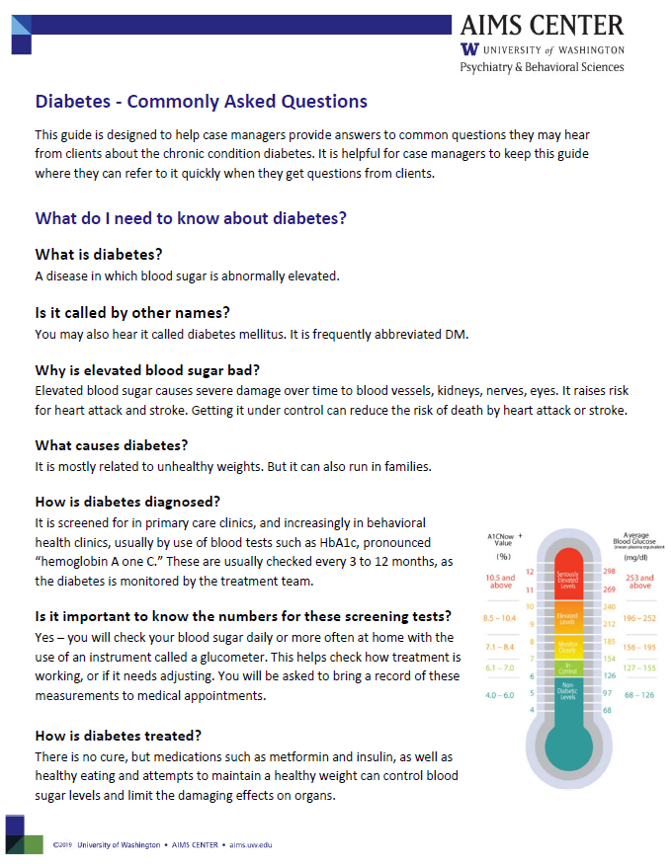
Chronic Health Condition Guides: Commonly Asked Client Questions
Brief, to be used as reference tool
Common conditions important for cardiovascular risk:
Hypertension
Diabetes
Hyperlipidemia
Notes:
Materials Prep Note: Add in - Asthma, COPD to the half day training
Facilitator Note:
Refer to Chronic Health Condition Guides - Commonly Asked Questions on chronic health conditions
These guides are designed to help case managers provide answers to common questions they may hear from clients about various chronic health conditions.
It is helpful to keep these guides where they can be referred to quickly, as you are asked questions, or need refeshers yourself.

Slide 54
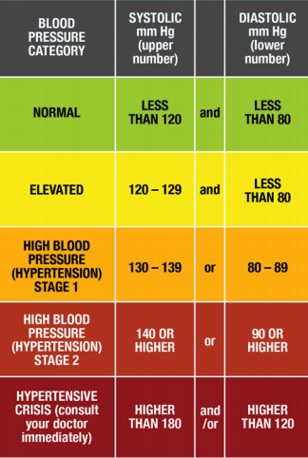
Hypertension (High Blood Pressure)
Elevated pressure in blood vessels
Increases the risk of death by stroke or heart attack
Treating
Medication
Health behavior change
Weight management, exercise
Smoking cessation
Limiting alcohol
Notes:
Facilitator Note:
Refer to Case Manager tool “Hypertension – Commonly Asked Questions”
Key Messages:
This slide is not comprehensive, but does highlight the big ideas about High Blood Pressure
Refer to the ‘Hypertension – Commonly Asked Questions’ guide as an additional tool to use while working with clients. It will help you to quickly and accurately address any questions or concerns clients might have about hypertension. Please take some time to read this through before using with a client.

Slide 55
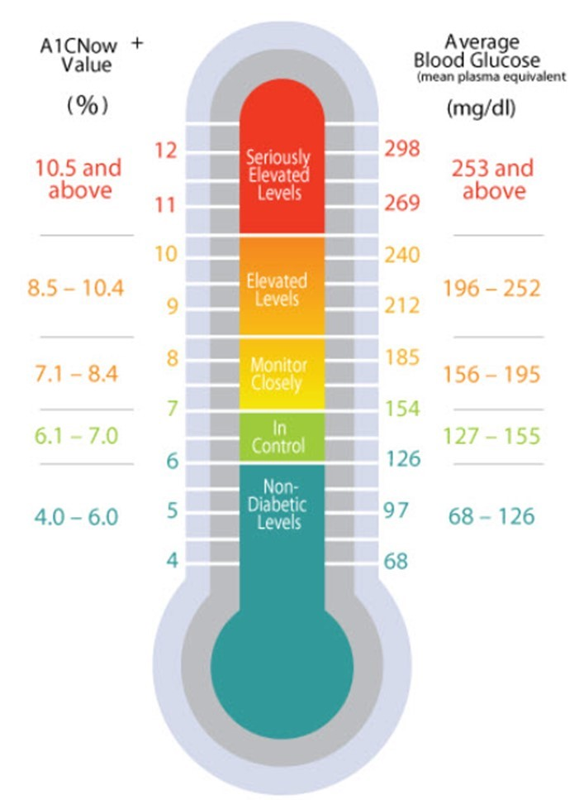
Diabetes Mellitus (DM)
Condition in which blood sugar is abnormally elevated
Damages eyes, kidneys, blood vessels
Usually related to overweight
Treated with dietary management, meds
Measurements of blood sugar followed closely
Notes:
Facilitator Note:
Refer to Case Manager tool “Diabetes – Commonly Asked Questions”
Key Messages:
This slide is not comprehensive, but does highlight the big ideas about diabetes mellitus.
Refer to the ‘Diabetes – Commonly Asked Questions’ guide as an additional tool to use while working with clients. It will help you to quickly and accurately address any questions or concerns clients might have about diabetes. Please take some time to read this through before using with a client.
Define what DM is
Describe the types
How else can I be helpful to the client?
Encourage them – taking care of diabetes is not easy, and they may be discouraged about the complications of treatment, about dietary restrictions, checking their blood sugar, etc.
Model healthy eating and support their efforts at physical activity.

Slide 56
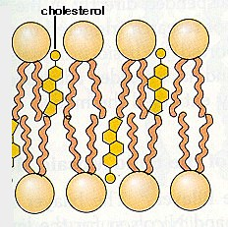
Cholesterol
A normal fat like substance found in your blood
A key component to cells
Comes from foods we eat
Notes:
Key Message(s):
People are always talking about cholesterol, and there are lots of mistaken ideas.

Slide 57
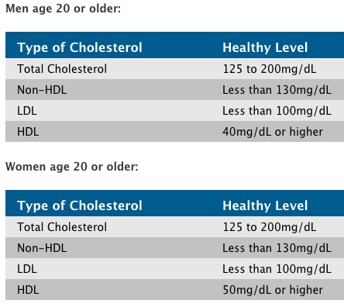
High Cholesterol - Hyperlipidemia
Hyperlipidemia
High levels of cholesterol in blood
Related to death by stroke or heart attack
Risk factors include obesity and genetics
Treated successfully with medication, weight reduction
Notes:
Facilitator Note:
Refer to Case Manager tool “Hyperlipidemia – Commonly Asked Questions”
Key Messages:
This slide is not comprehensive, but does highlight the big ideas about High Cholesterol.
Refer to the ‘Hyperlipidemia – Commonly Asked Questions’ guide as an additional tool to use while working with clients. Please take some time to read this through before using with a client.

Slide 58
Treat to Target: Physical Health Measures
Measure | Value | Condition
BMI | > 25 | Overweight
 | > 30 | Obese
Blood Pressure | > 130/80 | Hypertension/High Blood Pressure
 | > 180/120 | Hypertensive crisis (see MD or ER immediately)
HbA1c | > 5.7 | Prediabetes
 | > 6.5 | Diabetes
Lipids (LDL) | > 190 | Hyperlipidemia/High Cholesterol
Notes:
Key Message(s):
Because you, your client and your team will use these physical measures to assess whether your efforts are helping, and whether the client is getting healthier, it is handy to be able know what “good numbers” are.
A chart like this is something you can have handy and look up. After a few months, you probably won’t need the chart anymore.
You can also find some of these numbers on the Commonly Asked Questions guides

Slide 59
Unreliable Sources of Information on Medical Conditions
Notes:
Key Message(s):
Clients are going to talk with you about their health, and share ideas about how they view it.
Sometimes they will be misinformed in ways that are concerning.
With access to the internet, there is constant exposure to much nonsense that is difficult to distinguish from useful information.
This particular website is especially insidious, because a very unhelpful ad has been placed in the middle of a perfectly reasonable page of information on meds for HTN, which also has a link to a Harvard website of some kind. How to tell what is reliable?

Slide 60
Reliable Sources of Information on Medical Conditions
AIMS training and support materials!
Medical providers and nurses
Use the Internet with caution
Reliable sites include:
Medline Plus
WebMD
Mayo Clinic
American Heart Association
American Academy of Family Physicians
American Diabetes Association
Notes:
Key Message(s):
You are always talking and building relationships with clients and it is useful for you to be able to inform yourselves reliably to support the care of your client!
If you need to refer to the internet – here are some reliable sources. We will also be discussing different handouts you could use that will guide you on common medical conditions.
And when in doubt, consult your team and other professionals you work with!
Don’t make treatment decisions based on the internet; always check with your team!

Slide 61
Case Managers Do Not Diagnose Chronic Health Conditions in Clients
Will be identified by medical or psychiatric teams
Once identified, case managers support a client in managing these conditions
If a client shares information about a condition you think your team doesn't know about, let the team know
Notes:
Key Message(s):
How Will I Know if My Client Has One of These Conditions?
Clients being prescribed psychiatric medication should be getting screening labs which will detect the diseases. The agency also likely does screening labs prior
Case manager’s are critical to supporting clients manage these conditions after they’ve been identified by the medical or psychiatric teams.

Slide 62
Side Effects of Psychiatric Medications
Weight gain
Diabetes
High cholesterol and abnormal triglycerides
Insulin resistance
Notes:
Key Messages:
Psych meds are the cornerstone of treatment of SMI, but some of them contribute significantly to poor physical health and the development of cardiovascular disease.

Slide 63
Obesity and Impact of Antipsychotic Medications
Estimated Weight Change at 10 Weeks on “Standard” Dose
6
13.2
5
†
11.0
4
8.8
3
6.6
Weight Change (kg)
4.4
2
*
Weight Change (lb)
1
2.2
0
0
-1
-2.2
-2
-4.4
-3
-6.6
Placebo
Mesoridazine
Clozapine
Aripiprazole
Risperidone
Olanzapine
Fluphenazine
Haloperidol
Quetiapine
Ziprasidone
Thioridazine/
Chlorpromazine
*4–6 week pooled data (Marder SR et al. Schizophr Res. 2003;1;61:123-36; †6-week data adapted from Allison DB,Mentore JL, Heo M, et al. Am J Psychiatry. 1999;156:1686-1696; Jones AM et al. ACNP; 1999.
Notes:
Mean Change in Weight with Antipsychotics
Antipsychotic therapy is associated with differential risk of weight gain, depending on the individual agent
Some of the newer meds do not cause weight gain, including lurasidone, which was not available at the time of this study.
Some patients may only be stable on meds that cause weight gain, for example, some people only respond to clozapine. This is a real dilemma.
But other patients may tolerate a switch to a safer agent and remain well psychiatrically. Physical health is not the only priority , but one that is worth considering.
References
Allison DB, Mentore JL, Heo M, et al. Antipsychotic-induced weight gain: a comprehensive research synthesis. Am J Psychiatry. 1999;156:1686-1696.

Slide 64
So What Do We Do?
Health Behavior Change
Supporting Medical Care
Wise Prescribing
Notes:
Key Messages:
Case management interventions are really of these two kinds.

Slide 65
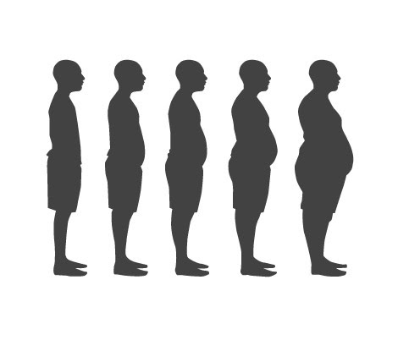
Modifiable Risk Factors
Obesity
Meds that cause weight gain
Smoking
Lack of exercise
Untreated medical illness
Notes:
Key Message(s):
Our efforts with clients to improve cardiovascular health will focus on those things that have actually been shown to make a difference.

Slide 66
Supporting Health Behavior Change
Not too much or too fast… you are in for the long run
Suggest the simplest behavior change
Help brainstorm to make change as effortless as possible
e.g. pills by the toothbrush or shoes by the bedside
Get an early win
Think of something that will make the client feel better soon i.e. a short walk together
Notes:
Key Message(s):
Really changing behavior is hard, especially if it is opposition to what your body wants to do.
It is best to start slow, and find a small change that the client can certainly succeed at and build confidence in their ability to change.
Being patient with “3 steps forward and 2 steps back” is essential – this is how it will go!

Slide 67
Obesity Management
A reasonable goal may be to reduce weight by 10% in 6 months. This can be achieved by the following:
Exercise
Dietary Change
Behavioral therapy
Medication
STRIDE program
A 30-Session group-based Weight Loss and Weight Maintenance Program for People who live with Mental Illness
Kaiser and NWMHTTC – coming soon!
Notes:
Key messages:
Overweight is hard to manage for anyone.
But some programs have been shown to be helpful – it is quite a bit of work.

Slide 68
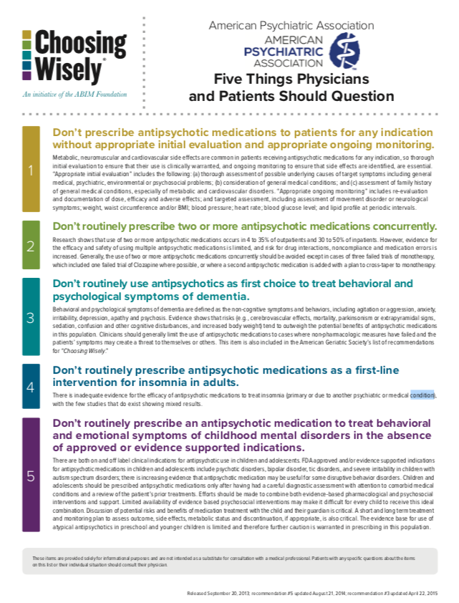
Wise Prescribing
Minimizing risk of obesity
http://www.choosingwisely.org/wp-content/uploads/2015/02/APA-Choosing-Wisely-List.pdf
Notes:
Key Message(s):
Medications that minimize the risk of obesity

Slide 69
Tobacco Cessation
Ask
About tobacco use
Advise
A follow-up plan
Assess
Assist
Arrange
To quit
Readiness to make a quit attempt
With making a quit attempt
Resource: https://www.doh.wa.gov/ForPublicHealthandHealthcareProviders/HealthcareProfessionsandFacilities/ProfessionalResources/TobaccoCessationResources
Notes:
Smoking cessation meds can improve chance of successful quitting by 4 X !

Slide 70
Smoking Cessation in SMI
Smoking prevalence has not decreased in SMI
50% of deaths in SMI attributable to tobacco
Cessation improves cognition and mental health outcomes
Chantix not associated with poor mental health outcomes
(Taylor et al. BMJ, 2014; Am J Psychiatry 2013; 170:1460–1467)
Notes:
Key Message(s):
Smoking cessation still the most powerful intervention in improving health
Psychiatrists can be effective here
Chantix Safety Study – N= 8027; No evidence that varenicline is associated with adverse neuropsychiatric events.

Slide 71
Supporting Health Behavior Change
Motivational Interviewing
Educating clients and staff
Why we are doing this?
Remember your elevator speech?
Taking care of the whole person
High level issues
Antipsychotic effects on weight
Major metabolic problems – Diabetes, Hypertension
Top 10 meds
Notes:
Key Message(s):

Slide 72
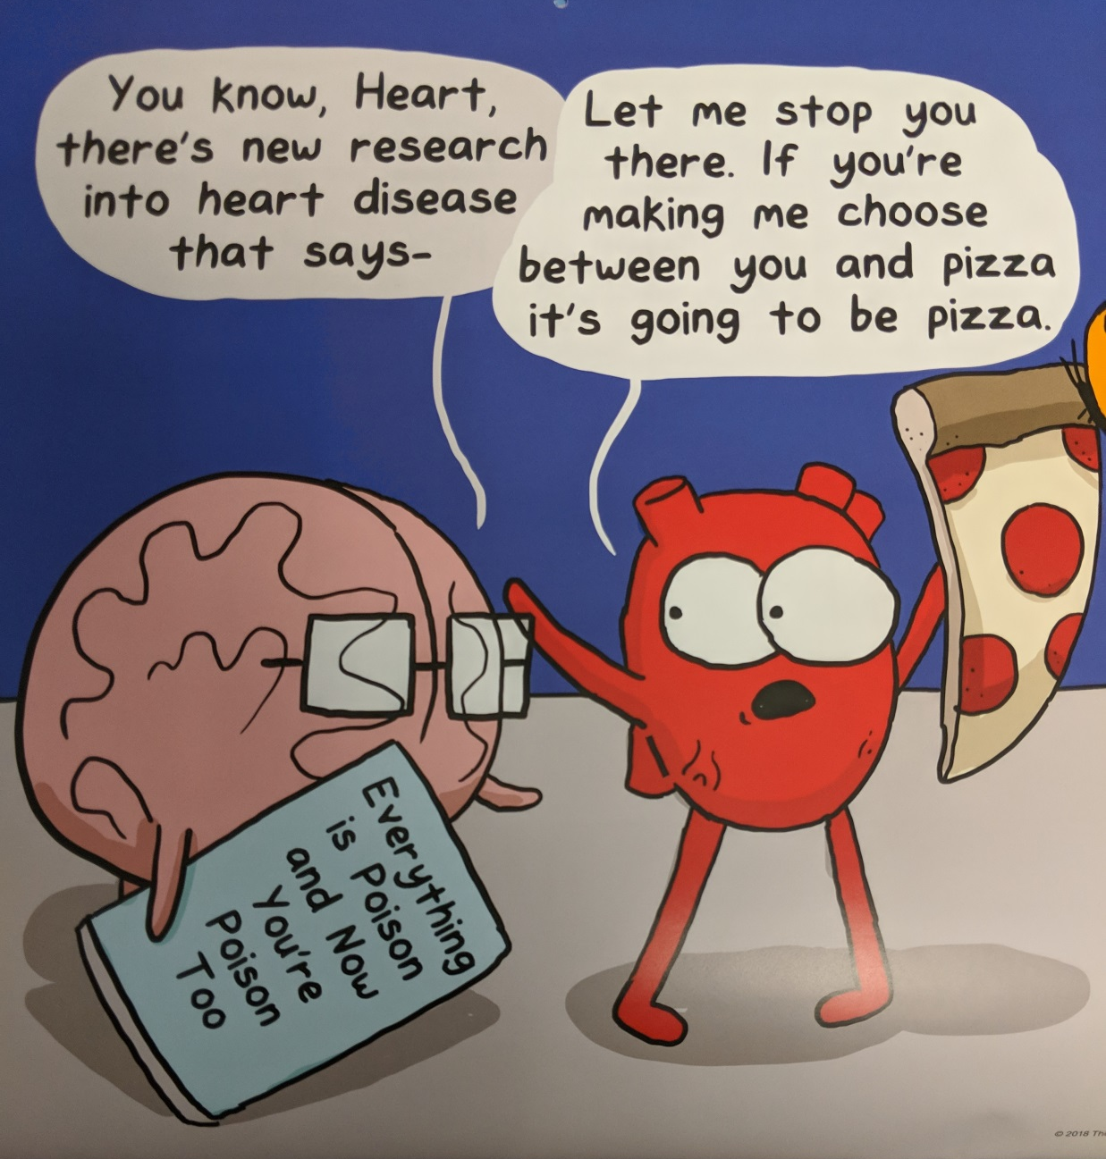
Notes:
Key Message(s):

Slide 73
Case Manager Role in Client Medical Care
Appointments
Making, keeping, using
Building relationships
With client, caregivers and primary care providers/teams
Healthy living
Reminding, encouraging, frequent contacts
Navigating Medical System
Interacting and interpreting
Advocating for your client
Notes:
Key Message(s):
One of the things that has been shown to make mental health agency-based efforts so effective is that fact that we have so many contacts with the client, compared to, say, a primary care provider, and more opportunities to build support for healthier living.
“All meaningful behavioral change occurs in the context of a personal relationship.” Joe Parks, MD Director, Missouri Health Homes Project

Slide 74
Low Hanging Fruit
BMI
Smoking
Hypertension
Lipids
Diabetes
Notes:
Key Message(s):
Treatment of BMI is tough in any population.
Hypertension, diabetes and dyslipidemias present unique opportunities if you can at least get patients on medications while you are negotiating life style changes.
SAVES HEALTH CARE DOLLARS

Slide 75
Learning Activity: Choose the Low-Hanging Fruit! Win Fabulous Prizes!
Notes:
Key Message(s):
Remember “Let’s Make A Deal?”
Here we will stop for a break to quiz ourselves on interventions that really make a big difference!

Slide 76
Round 1: Which is the Low-Hanging Fruit?
Restarting preventative COPD meds
Weekly Zumba class
Group education about diabetes
Notes:
Key Message(s):
As the team is deciding on what to do, what should be the first consideration?

Slide 77
Round 1: Which is the Low-Hanging Fruit?
Restarting preventative COPD meds
Weekly Zumba class
Group education about diabetes
“…inhaled corticosteroids (ICS) decrease hospital admissions, ED visits, and even deaths in children with persistent asthma. ”
Popul Health Manag. 2015 Feb 1; 18(1): 54–60.
Notes:
Key Message(s):
What does the evidence say makes people healthier…

Slide 78
Round 2: Which is the Low-Hanging Fruit?
Healthy Workplace initiative at BHA
Ensuring blood pressure meds adherence
Searching clients apartment for frozen pizza collection
Notes:
Key Message(s):

Slide 79
Round 2: Which is the Low-Hanging Fruit?
Healthy Workplace initiative at BHA
Ensuring blood pressure meds adherence
Searching clients apartment for frozen pizza collection
Cholesterol
↓10%
10% ↓ in cardiovascular disease
Blood Pressure
↓6mm/Hg
16% ↓ in cardiovascular disease
42% ↓ in stroke
Notes:
Key Message(s):

Slide 80
Round 3: Which is the Low-Hanging Fruit?
Instruction in Mindfulness meditation
Regular visits to local farmer’s market
Successful engagement with case manager
Notes:
Key Message(s):

Slide 81
Round 3: Which is the Low-Hanging Fruit?
Instruction in mindfulness meditation
Regular visits to local farmer’s market
Successful engagement with case manager
“Meaningful behavioral change always happens in the context of a personal relationship.”
Notes:
Key Message(s):

Slide 82
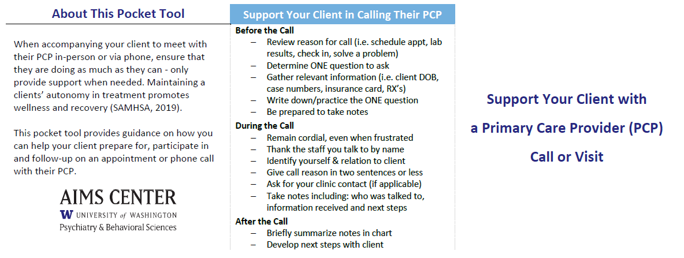
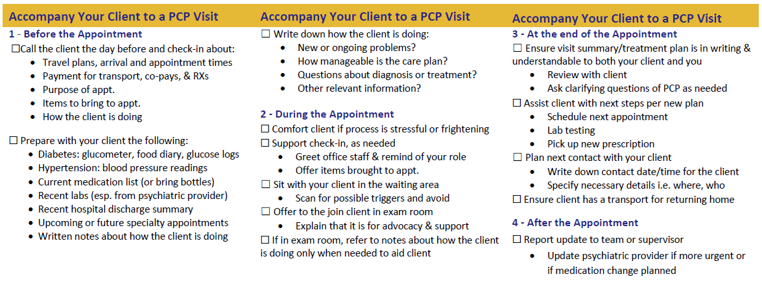
Pocket Tool: Support Your Client With a Primary Care Provider Call or Visit
Notes:
Key Message(s):
This pocket tool provides guidance on how you can help your client prepare for, participate in and follow-up on an appointment (Yellow banner) or phone call (light blue banner) with their primary care provider.
When accompanying your client to meet with their primary care provider via phone or in-person ensure that they are doing as much as they can. You are helping them to build skills for living. Only provide support when needed. Maintaining a clients’ autonomy in treatment promotes wellness and recovery (Samhsa, 2019).

Slide 83
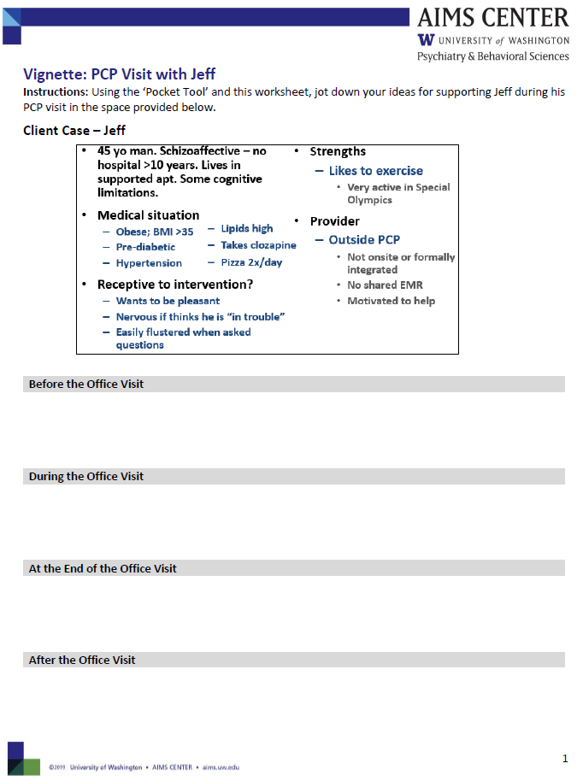
Learning Activity: PCP Visit Vignette
Instructions:
Follow along with Jeff’s case
Use the ‘Pocket Tool’ to help us support Jeff during his PCP visit
Jot down ideas on the “Vignette: PCP Visit with Jeff” handout
Notes:
Key Message(s):
Now we will try out the “Visit Support tool” with a vignette based on a real client’s visit, and see how it can be useful.

Slide 84
Client Case – “Jeff”
45 yo man. Schizoaffective – no hospital >10 years. Lives in supported apt. Some cognitive limitations.
Medical situation
Obese; BMI >35
Pre-diabetic
Hypertension
Receptive to intervention?
Wants to be pleasant
Nervous if thinks he is “in trouble”
Easily flustered when asked questions
Strengths
Likes to exercise
Very active in Special Olympics
Provider
Outside PCP
Not onsite or formally integrated
No shared EMR
Motivated to help
Lipids high
Takes clozapine
Pizza 2x/day
Notes:
Key Message(s):

Slide 85
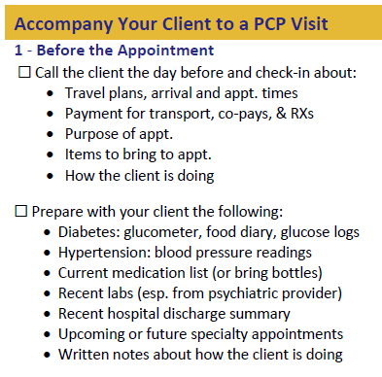
Before the Office Visit with Jeff
Reminder call
Jeff does not have a transport plan
Help Jeff arrange w/ community transit
Check-in & discuss
Jeff wonders about his diabetes
Use diabetes guide to explain; write down that may want to discuss further with PCP
Plan to Bring
Jeff will bring his:
Blood sugar records
Blood pressure records
Medication box
Ensure all concerns are addressed
“Anything else before we go?”
You will bring
Jeff’s most recent labs
Notes:
Key Messages:
Use the tool as a reminder for all the many things to remember and bring, as well as the preparation that the client should make before the appointment, because once you are there, your memory may let you down!
Encourage the attendees to share their experience with as many of the bullet points as possible, then share what we actually did on the right.
Share the Diabetes handout when we get to that part under “Check-in & discuss”

Slide 86
During the Office Visit with Jeff
In exam room with PCP
Jeff explains he’s been exercising and is trying to cut back on pizza
PCP advises
ADA plate
One pizza-free day possible?
Simplify med regimen to once daily
PCP points out that Jeff’s #’s are better, if not normal
Remind Jeff of his question about his diabetes, referring to written notes
Support client with logistics
Jeff is nervous and doesn't want to bother front office staff
Kindly remind Jeff to check-in
You ask to join in exam room
Jeff agrees
Notes:
Key Message(s):
The waiting room can be difficult, and a lot of appointments go awry there. Here are some tips – what experiences have attendees had?
Then talk about what we did:
What do you notice? We are not checking in FOR Jeff when first getting there or speaking FOR Jeff while in the room with the PCP. Rather, we are providing a supportive presence based on what we know about Jeff’s needs from our time working with and building our relationship with him. As outlined in the client case, Jeff tends to get ‘Easily flustered when asked questions’ but is otherwise is independent

Slide 87
At the End of the Office Visit
Assist with Next Steps
Jeff re-arranges med box
Both identify which day he will try to not eat pizza; write down
Plan Next Contact
Also write down & share all notes with Jeff
Affirm and encourage again, “What a long day!”
Debrief visit with PCP
Affirm Jeff for improved #s; acknowledge hard work!
Write down summary
Notes:
Key Message(s):

Slide 88
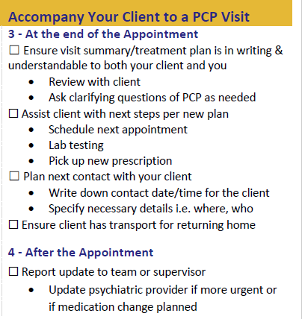
After the Office Visit with Jeff
Update team
Document and share plans
Update psychiatric provider about medication change
Notes:
Key Message(s):
Plan feedback to your team
Make sure client has a plan for what happens next

Slide 89
Reflection & Discussion
Remember a time you accompanied someone to a doctor's appointment…
What was challenging?
How did it go?
What did you do that was effective?
What did you do that was not as effective?
Notes:
Key Message(s):
Was it effective in improving their care?

Slide 90
Action Planning
Notes:
Length: 2 minutes
Key Message(s):
After each session write down ideas, inspirations, or other things you want to take back to your organization to shape your work.
In this case it could be: continuing to practice and refine your elevator speech,

Slide 91
Lunch
Notes:
We’ll return at 12:30 all in this room.

Slide 92
Using Whole Person Care Tools to Improve Health Outcomes for People with Serious Mental Illness
Session 4
Notes:
The tools we review in this session are intended to provide a structure for your thinking and activity to support your clients’ physical health.

Slide 93
Learning Objectives
By the end of this session, participants should be able to:
Demonstrate different interventions to try when working with clients to improve health outcomes
Use AIMS Center tools to create plans with clients to address specific barriers to care
Notes:
Key Message(s):

Slide 94
What Do I Do When My Client Isn’t Getting Healthier?
Notes:
Key messages:
This tool is intended to give you ideas and reminders about what might be getting in your clients’ way, and strategies for how you might intervene.
It is not always easy to figure out what the problem is, or how to intervene, but having an organized approach can help.

Slide 95
Exercise: Generate Case Management Ideas
Pills are a mess
Client agrees, but doesn’t function
Family opposed
Active psychiatric illness
Over-leveraging the relationship
Non-symptomatic client
Other BH staff disparaging
PCP not welcoming
Client adherent, but still not getting better
Child with diabetes and adherence problems
Notes:
Key messages:
Here we will use our tool – applying it to a number of real-life stories about where clients could benefit from intervention.

Slide 96
Directions
Read the vignettes
Talk to your team
What might barriers be?
What more information do we need?
Look at the intervention handout– are there ideas there?
Would this work back at your place?
Notes:
Key messages:
This is a structure for thinking about and planning interventions.

Slide 97
Plans for Your “Vignette” Clients
Notes:
Key messages:
This tool is for planning your approach to your caseload, including prompts for frequent activities.

Slide 98
Now: Using the Tools for Your Challenging Client
Challenging client you work with
Can you use the tools for ideas?
Share with a partner
Report out
Notes:
Key messages:
Tell us a story about what you have worked with.

Slide 99
Reflections
List one thing you intend to change or bring back to your agency?
What would you change or add to the AIMS Center tools?

Slide 100
Action Planning
Notes:
Length: 2 minutes
Key Message(s):
After each session write down ideas, inspirations, or other things you want to take back to your organization to shape your work.
In this case it could be: thinking about your team structure, roles and functions fulfilled by those roles

Slide 101
Evaluation

Slide 102
Thank you

