Slide 1
BHT Learning Cohorts March 28, 2019

Slide 2
Screening for Social Determinants of Health
Bruce Goldberg, MD
Anne King, MBA

Slide 3
Session Outline:
Session Goals
Context for Screening
Screening Tools & Implementation Considerations
Business Case for Screening
Patient-Centered Screening
Data “Systems”
Partnership Strategies
Closing Remarks

Slide 4
Session Goals:
Understand the variety of screening tools in use around the country
Explore opportunities to screen patients in a patient-centered way
Consider the rationale for and ways to develop a screening strategy, partnerships and workflows for your organizations and populations

Slide 5
Context for Screening

Slide 6
What are Social Determinants of Health?
“…the economic and social conditions that influence ... health" (Commission on Social Determinants of Health, 2008).

Slide 7
NATIONAL CONTEXT
Health care costs growing faster than other economic indicators
Outcomes are varied and inconsistent
National health reform efforts – SIM, Medicare, PCMH, CPC+
A plethora of state health reform efforts
Growing evidence of importance of social investments, care coordination, primary care

Slide 8
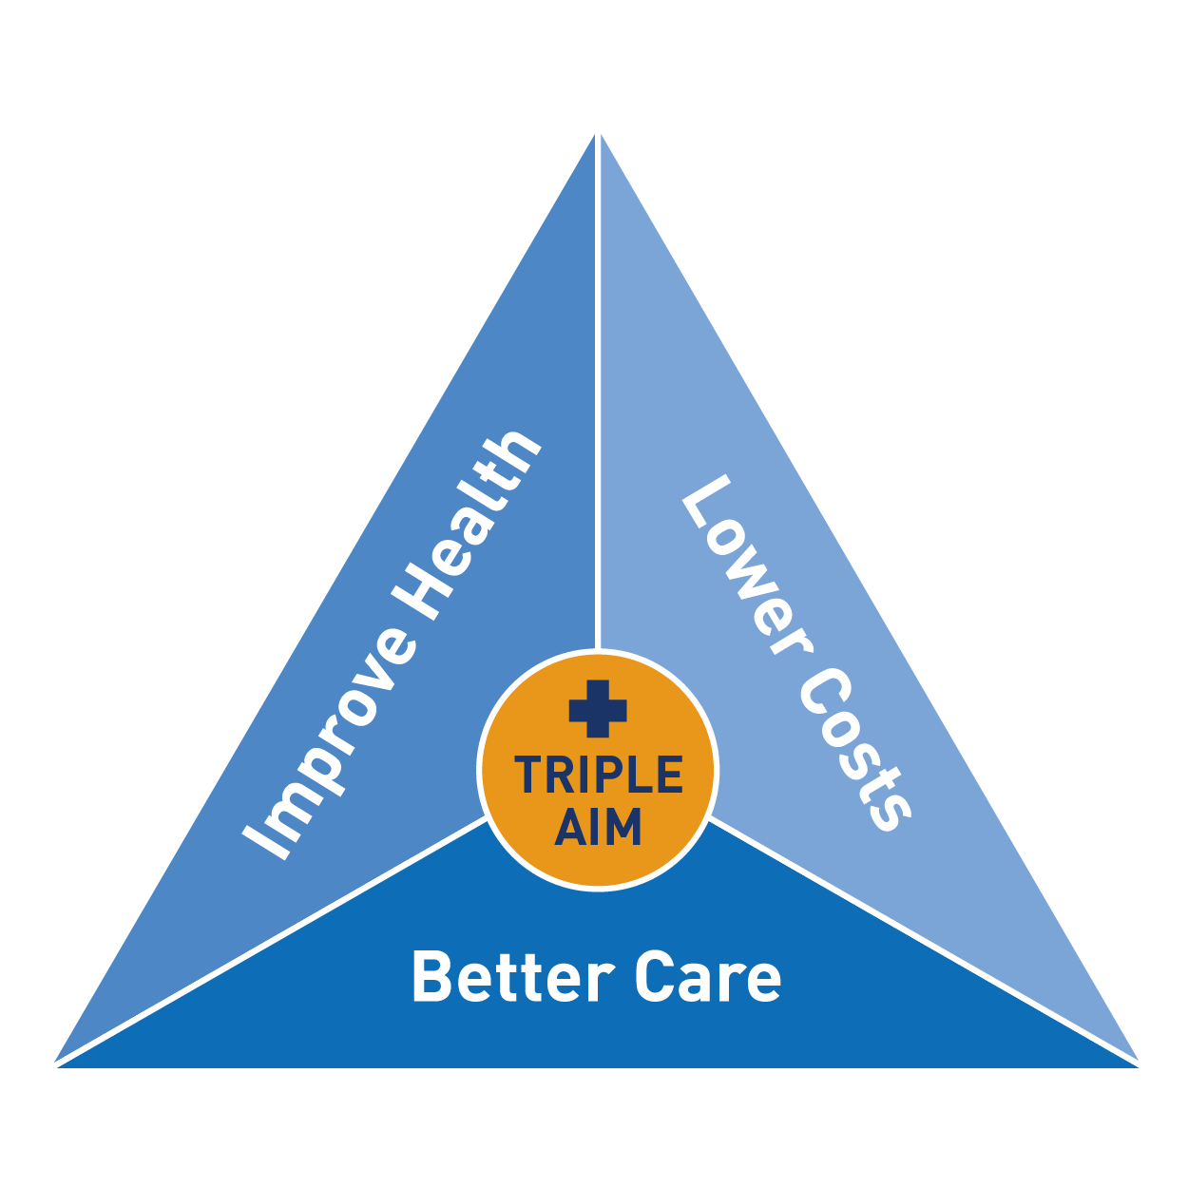

Slide 9
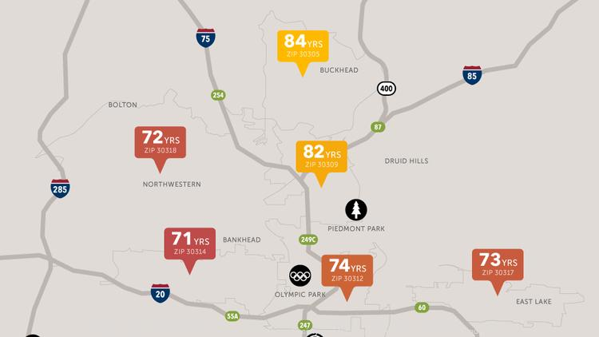

Slide 10
Notes:
10

Slide 11
Health Expenditures as % of GDP, 2009
20
18
16
14
12
10
8
6
4
2
0
Elizabeth Bradley, PhD

Slide 12
Total Investment in Health as % of GDP
Elizabeth Bradley, PhD

Slide 13
Opportunity Costs!
1 ED Visit = 1 months rent
2 hospitalizations = 1 year of child care
20 MRIs = 1 social worker per year
60 echocardiograms = 1 public school teacher per year

Slide 14
HOW DO YOU INCREASE INVESTMENTS MADE INTO SOCIAL DETERMINANTS??
Notes:
Still have to provide Medicaid covered benefits

Slide 15
STATE EFFORTS TO IMPROVE HEALTH & INCREASE INVESTMENTS IN SOCIAL SPENDING
Foster better value and efficiency in health delivery systems through payment reforms, value based purchasing and delivery system changes
Invest some of those savings into social enterprises that improve health
Increased partnerships across health and social service endeavors
Creating coordinating/integrating organizations
Notes:
Still have to provide Medicaid covered benefits

Slide 16
The Alphabet Soup of Approaches
ACO
CCO
ACC
ACH
CPC
AHC
RCCO
MCO
PCMH

Slide 17
Social Determinants of Health Screening Tools

Slide 18
Considerations for Selecting a Tool
Population
Which social needs
Screening “dosage”
Handling screening results
Implementation considerations
Other?
Notes:
Different tools for adults, kids, some work for both
Time- how many questions, how long they take, opportunities to piggyback. opportunity costs to more critical clinical activities or other screens
Administration modality (paper, direct to EHR, tablet, email, text, patient portals).
Workflows (who/when/how)

Slide 19
Population
Adults, pediatrics, all patients, ?
Subgroup, by:
Healthcare utilization
Insurance status
Chronic disease(s)
Co-existing conditions (e.g. mental illness, addiction)
Age subgroups (e.g. very old, very young)
Zip code
Other?

Slide 20
Which Social Needs? Screening Tools- Adults & Gen. Pop.
DOMAINS | AHC-Tool | HealthBegins | Health Leads | MLP IHELLP | NAM Domains | PRAPARE | WellRx | Your Current Life Situation
Education
Financial strain
Food insecurity
Housing insecurity/ instability/homeless
Housing quality
Interpersonal violence
Social support
Stress
Transportation
Utilities
https://sirenetwork.ucsf.edu/tools-resources/mmi/screening-tools-comparison

Slide 21
Which Social Needs? Screening Tools- Pediatrics
Domains | iHELP | SEEK | SWYC | We Care
Education
Financial strain
Food insecurity
Housing insecurity/ instability/homeless
Housing quality
Interpersonal violence (IPV)
Social support
Stress
Utilities
https://sirenetwork.ucsf.edu/tools-resources/mmi/screening-tools-comparison

Slide 22
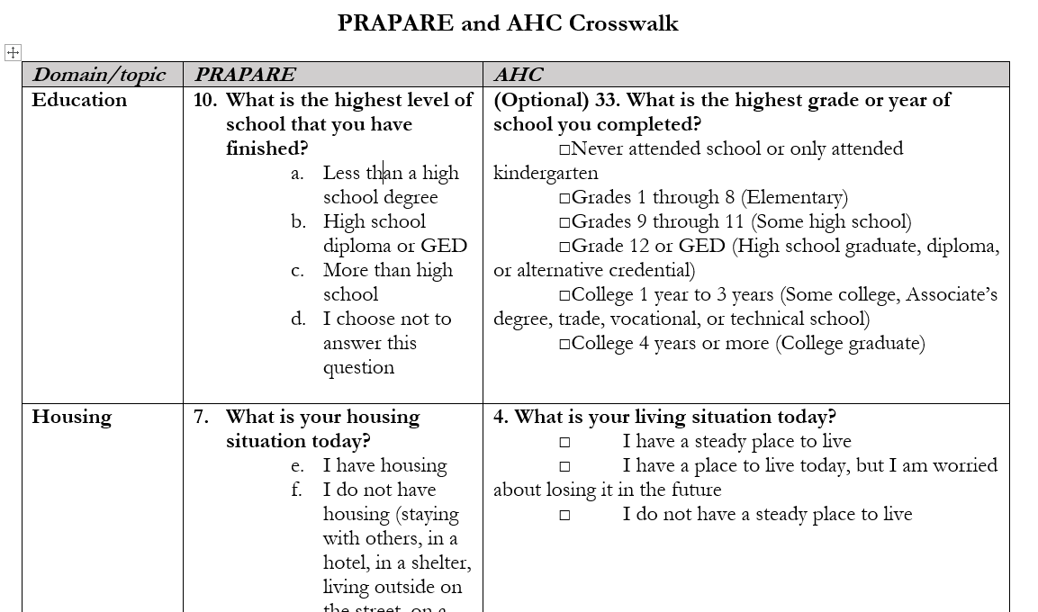
Many of the questions are similar
Domain/topic | PRAPARE | AHC
Education | What is the highest level of school that you have finished? Less than a high school degree High school diploma or GED More than high school I choose not to answer this question | (Optional) 33. What is the highest grade or year of school you completed? □Never attended school or only attended kindergarten □Grades 1 through 8 (Elementary) □Grades 9 through 11 (Some high school) □Grade 12 or GED (High school graduate, diploma, or alternative credential) □College 1 year to 3 years (Some college, Associate’s degree, trade, vocational, or technical school) □College 4 years or more (College graduate)
Housing | What is your housing situation today? I have housing I do not have housing (staying with others, in a hotel, in a shelter, living outside on the street, on a beach, in a car, or in a park) I choose not to answer this question Are you worried about losing your housing? Yes No I choose not to answer this question | 4. What is your living situation today? □ I have a steady place to live □ I have a place to live today, but I am worried about losing it in the future □ I do not have a steady place to live
Transportation | Has lack of transportation kept you from medical appointments, meetings, work, or from getting things needed for daily living? [Check all that apply] Yes, it has kept me from my medical appointments or from getting my medications Yes, it has kept me from my non-medical meetings, appointments, work, or from getting things that I need No I choose not to answer this question | 8. In the past 12 months, has lack of reliable transportation kept you from medical appointments, meetings, work or from getting to things needed for daily living? □ Yes □ No
Food | In the past year, have you or any family members you live with been unable to get any of the following when it was really needed? Check all that apply. Food (other options) OCHIN Epic (same as AHC) | 6. Within the past 12 months, you worried that your food would run out before you got money to buy more. □ Often true □ Sometimes true □ Never true 7. Within the past 12 months, the food you bought just didn't last and you didn't have money to get more. □ Often true □ Sometimes true □ Never true
Utilities | In the past year, have you or any family members you live with been unable to get any of the following when it was really needed? Check all that apply. Utilities | 9. In the past 12 months has the electric, gas, oil, or water company threatened to shut off services in your home? □ Yes □ No □ Already shut off
Domestic violence/safety | Do you feel physically and emotionally safe where you currently live? Yes No Unsure I choose not to answer this question In the past year, have you been afraid of your partner or ex-partner? Yes No Unsure I have not had a partner in the past year I choose not to answer | 10. How often does anyone, including family and friends, physically hurt you? □ Never □ Rarely □ Sometimes □ Fairly often □ Frequently 11. How often does anyone, including family and friends, insult or talk down to you? □ Never □ Rarely □ Sometimes □ Fairly often □ Frequently 12. How often does anyone, including family and friends, threaten you with harm? □ Never □ Rarely □ Sometimes □ Fairly often □ Frequently 13. How often does anyone, including family and friends, scream or curse at you? □ Never □ Rarely □ Sometimes □ Fairly often □ Frequently

Slide 23
Patient Experience of Screening for SDOH
Research thus far:
Little patient discomfort with SDOH screening (LaForge et al, 2018)
Low patient refusal rates (LaForge et al, 2018; Giuse et al., 2017; Page-Reeves et al., 2016; Pinto et al., 2016)

Slide 24
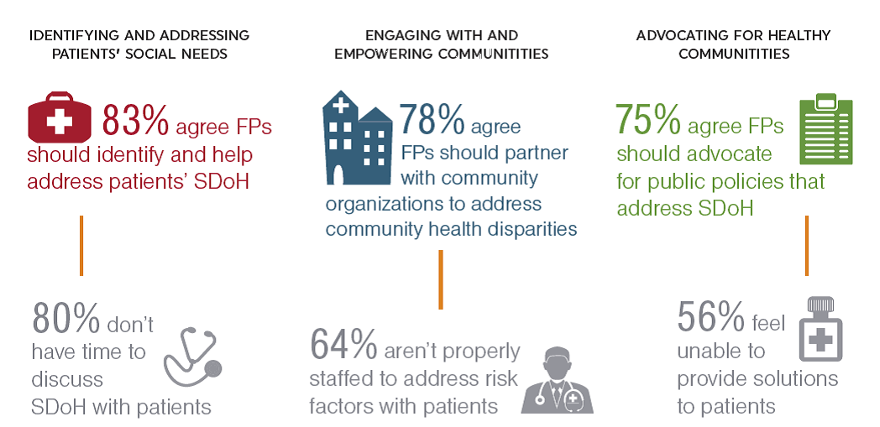
Clinician Experience of Screening for SDOH
Source: https://www.aafp.org/dam/AAFP/documents/patient_care/everyone_project/sdoh-survey-results.pdf
Notes:
Need to determine how you want to do this. Biggest issue is how do you address some of the issues if they are positive.

Slide 25
Who will do the screening?
Registration
Intake
Care Management
Care coordination
Front desk
CHW
MA
Behaviorist
Counselor
Nurse
Physician
Psychiatrist
???

Slide 26
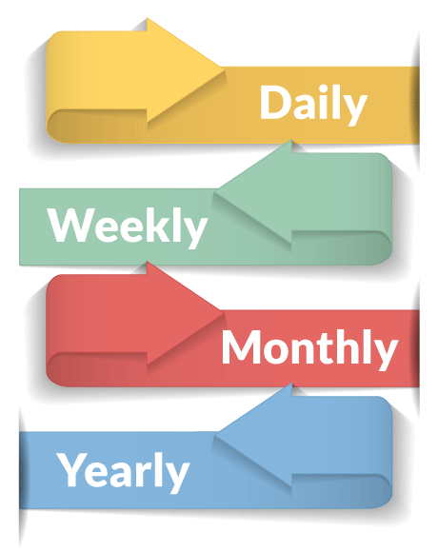
“Dosage” of Screening
Notes:
People’s circumstances change, how often?

Slide 27
Timing
At…
registration
intake
care coordination
new diagnosis
?
?
Notes:
Issues to consider- when do you want to do this?

Slide 28
Other Considerations
How long does it take to do the screening?
Can the patients screen themselves?
Other?

Slide 29
Followup
What will you do for positive screens?
Provide potential resources
Counsel
Refer
?
Who will do the follow up?
Notes:
Clinician training- AHC clinicians reporting needing training in handling verbal abuse, also wanted training again on physical abuse
Referral to community resources
New roles in clinic (e.g. primary care in BH, BH in primary care; CHWs; social workers)
New partnerships (community agencies, public health)
Follow up could depend on which questions- dental example

Slide 30
Why screen if you have no resources?
Notes:
-understand need that can’t be met and identify resources that are needed, inform policy and resource allocation
-spark collaborations with groups that can meet the need
-identify roles in care team that may need to be added

Slide 31
Accountable Health Communities Screening
Screening for 5 health-related social needs: housing, food, utilities, transportation and violence
Connecting patients with social needs to community services
Developing tailored referral and care plan for a subset of high risk patients
Notes:
More questions we could have included, but decided not to.
Screening tool takes 5 min- self screening, 10 min- facilitated screening
Available in lots of languages

Slide 32
Screening & Navigation Settings
Screening:
Primary Care (Family Medicine, Internal Medicine, Pediatrics)
Behavioral Health
Hospital
Public Health
Dental Providers
CCOs, Community Agencies

Slide 33
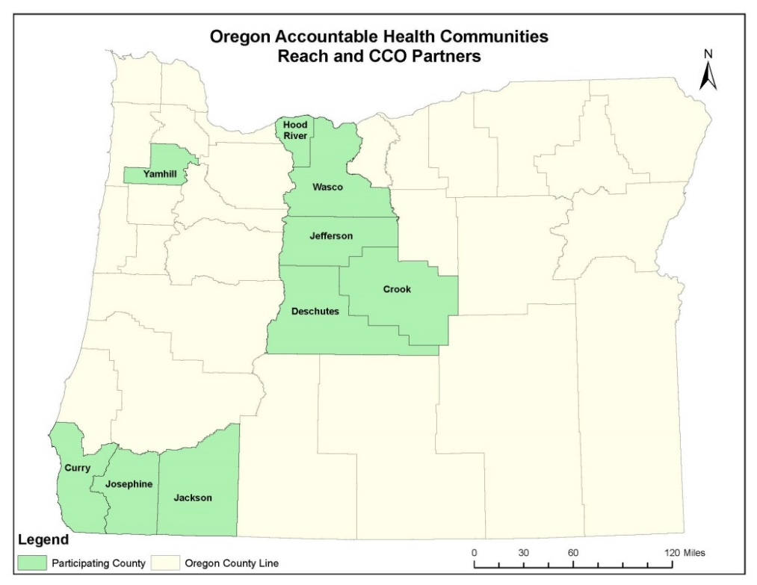
AHC Geography and Numbers
Collaboration across 9 counties in partnership with 6 CCOs, IPAs, health systems, and over 50 clinical sites
Screening 75,000 Medicaid and Medicare patients a year
Navigating for 3,000 high risk patients annually
Notes:
¼ of pop of Med/Med

Slide 34
Community Resource Summary
Tailored to identified social need
Delivered at a clinical visit via a warm handoff

Slide 35
Table Activity
In your table groups:
Share your name, organization and role
Are you currently screening for social needs? If so, for what needs?
If not, are you interested in doing so? If so,
What social needs would you want to screen for?
What do you think you need to get started?

Slide 36
Business Case for SDOH screening

Slide 37
First off…
There’s not enough high quality research on the health or cost impacts of screening for and addressing social determinants within a healthcare context.
For example…
Gottlieb, Wing and Alder, 2017 systematic review on effectiveness of interventions to connect social & medical care:
Of 4,995 articles 67 studies met inclusion criteria.
Of these 40 studies had non-experimental designs
Wide heterogeneity in outcome measures of the remaining 27
Bottom line– more high quality research with common
utilization outcomes is needed
Notes:
The business case for screening for social needs and addressing those needs in a healthcare context is difficult to make. There’s not enough high quality research on whether screening alone has any effect on health outcomes. We know that providing social services leads to better health outcomes, but those studies are not done for the most part within the health care sector. There’s little research on cost and cost avoidance, and what there is looks at small populations over short time frames. So avoidance of future disease isn’t well captured. We also don’t know much about patient-centered metrics such as patient satisfaction and perception of health as their social needs are addressed. Finally, digging into this topic also brings up a lot of questions about who is best prepared to do this work, where the costs of addressing social needs should live, and other thorny questions. So, overall, there’s a little data to support the business case, and a whole lot of questions. However, there are enough data to support working to develop a case.

Slide 38
Wealth & Health
Wealth contributes to:
Higher life expectancy
Lower rates of chronic disease
Lower rates of unhealthy behaviors (e.g. poor diet, smoking, physical inactivity)
https://www.rwjf.org/content/dam/farm/reports/issue_briefs/2011/rwjf70442
Notes:
Business problem or opportunity- We do know from the literature that there’s an association between wealth and health. As wealth increases, so do important markers of health, such as higher life expectancy, lower chronic disease rates, and lower rates of unhealthy behaviors, such as poor nutrition, tobacco use and physical inactivity.

Slide 39
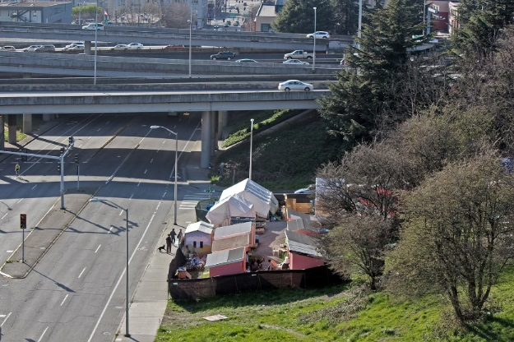
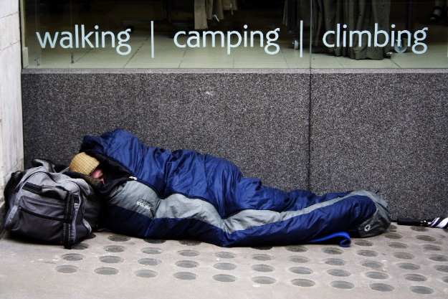
Social Needs & Health
People with social needs:
Obtain fewer preventive services
Use more emergency services
Have increased chronic health conditions
Have higher readmission rates
Have poorer health outcomes
(McKelvey, 2017) (Meddings, 2017)
Notes:
Business problem or opportunity- In fact, we know that poor people with substantial social needs obtain fewer preventive services and utilize more emergency services. They have more chronic health conditions, have higher rates of readmission to hospitals and have poorer health outcomes overall. So we have the beginnings of a business problem for healthcare– our patients with social needs fare worse in health outcomes than our patients without social needs.

Slide 40
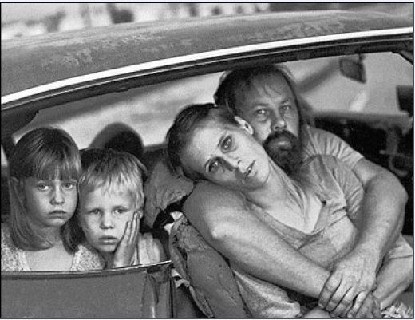
In Children…
More ACEs (e.g. homelessness, food insecurity, violence, divorce, etc.) = Worse Health Outcomes
Alcoholism and alcohol abuse
Smoking
Unintended pregnancies
Early initiation of smoking
Chronic obstructive pulmonary disease
Depression
Fetal death
Ischemic heart disease
Liver disease
Sexually transmitted diseases
Illicit drug use
(Kaiser, 1998)
Notes:
Business problem or opportunity- In fact, from the Kaiser study on Adverse Childhood Experiences or ACEs, we have excellent data on how poorly children with social needs fare on healthy behaviors and health outcomes as they age. Children who have ACEs fare worse than their peers on COPD, depression, heart disease and diseases relating to substance misuse and smoking.

Slide 41
Problem/Opportunity
Patients with social needs are faring worse in health outcomes and healthy behaviors than other patients.
By addressing social needs we should be able to improve our patients’ health outcomes.

Slide 42
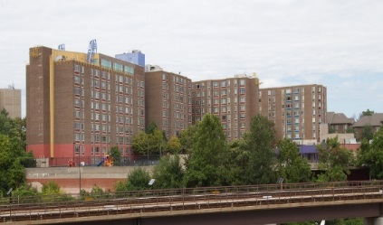
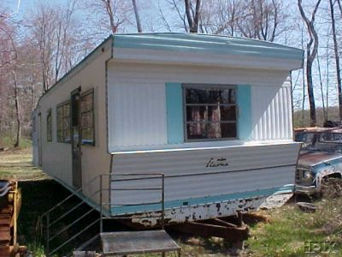
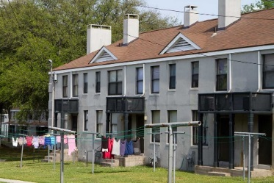
Housing & Healthcare Research- Benefits & Costs
Housing improvements (heating, ventilation) improved asthma symptom scores and reduced health care costs
Housing for low income elders with care coordination, advance planning, medication management reduced ED visits, unplanned hospitalizations and nursing home transfers
Housing for chronically homeless with severe alcohol problems decreased total health care spending 53% for housed vs. wait-listed controls
Supportive housing reduced overall health care expenditures, primarily through lower ED and inpatient care costs
1. Barton, 2007, Edwards, 2011, Garland, 2013; 2. Castle, 2014; 3. Larimer, 2009; 4. Wright, 2016, Gusmano, 2018, Counsell, 2008
Notes:
What are the benefits and costs of working on social determinants in health care, and what could that work be comprised of?: In terms of cost reductions- on the positive side there are studies that show a reduction in healthcare costs that can be captured through addressing social determinants. These are primarily through housing improvements and co-locating supportive services with housing (such as care coordination, treatment services.) These efforts surely have an upfront cost of getting programs going which aren’t captured in the research.
Lauren A. Taylor,¹ Annabel Xulin Tan,² Caitlin E. Coyle,² Chima Ndumele,² Erika Rogan,² Maureen Canavan,² Leslie A. Curry,² and Elizabeth H. Bradley² Leveraging the Social Determinants of Health: What Works?

Slide 43
Nutrition & Healthcare Research- Benefits & Costs
Increased fruit and vegetable consumption reduced cancer incidence, but overall cost of health care the same (Gundgaard 2003)
Higher BMI an important risk factor for chronic diseases (coronary heart disease, type 2 diabetes, hypertension, selected cancers, musculoskeletal disorders) Costs also rise as BMI rises (see below)(Pi-Sunyer, 1993)
Notes:
Costs: Looking at healthcare cost avoidance and nutrition, I found an interesting 2003 study where researchers looked at the nutrition of 20% of the Danish population over time. That study found that although increased fruit and vegetable consumption reduced the incidence of cancers, overall healthcare costs were similar across the population since patients who avoided cancer through nutrition lived longer, thus requiring more healthcare services over their lifetimes. We rarely get these massive longitudinal studies to help us make decisions, but we know that quality of food and outcomes of healthy nutrition and exercise lead to lower incidence of and thus costs of treatment of certain conditions– such as coronary heart disease, type 2 diabetes, hypertension, cancers and other disorders- as you can see from the increase in cost ratios for prescription drugs, outpatient services, inpatient care and overall medical care for cohorts of normal, overweight and obese patients.
Lauren A. Taylor,¹ Annabel Xulin Tan,² Caitlin E. Coyle,² Chima Ndumele,² Erika Rogan,² Maureen Canavan,² Leslie A. Curry,² and Elizabeth H. Bradley² Leveraging the Social Determinants of Health: What Works?

Slide 44
Education & Healthcare Benefits & Costs
Early childhood education results in: (as cited in Thornton, 2016)
Increased safety belt use and reduced smoking and illicit substance use (Karoly, 2005)
Reduced systems of depression, lower marijuana use, and increased physical activity (Campbell, 2012)
Lower body mass index and fewer risk factors for cardiovascular and metabolic disease (Campbell, 2014)
Societal ROIs from early childhood education investments range from $3-$17 per dollar invested (Karoly, 2005.)
Notes:
There’s a fair amount of research that shows that early childhood education results in better health outcomes and healthier behaviors when those children are adults. There’s also research that there’s a positive societal ROI of this work.
Karoly LA, Kilburn MR, Cannon JS. Early childhood interventions: Proven results, future promise. Santa Monica, CA: RAND Corporation; 2005. [Ref list]
As cited in Thornton, et. al, Evaluating Strategies for Reducing Health Disparities by Addressing the Social Determinants of Health, Health Affairs, 2016 Aub 1: 35(8): 1416-1423

Slide 45
Risks
From Accountable Health Communities discussions:
May uncover needs that can’t be met
Legal risk (e.g. safety needs)
Cause problems for other sectors
Cause challenges in busy clinical settings
Notes:
Risks we’ve heard from AHC- participating clinics: screening may uncover needs that cannot be met; patients with safety needs might be identified but then fall through the cracks raising issues of safety and liability; screening; healthcare takes on responsibility for other sectors

Slide 46
Patient-centered screening

Slide 47
Patient-centered screening
Patients own their story and their information
Allow patients to skip questions
Allow patients to stop answering questions at any time
Consider the screening environment

Slide 48
Patient-centered screening
Patients own their story and their information
Obtain consent to screen
Explain why you are screening
Explain how the information will be used and shared

Slide 49
Patient-centered screening
Trauma history
Culture
Prior experience with healthcare
Economic, other disparities
Comfort level with modality of screening (writing, verbal)

Slide 50
Cultural Identity Informs:
Concepts of health, healing
How illness, disease, and their causes are perceived
The behaviors of patients who are seeking health care
Attitudes toward health care providers
Feelings of safety and inclusion when seeking care
Source of slide: PacificSource CCO
Notes:
Patients with language barriers are less likely to have consistent medical care, use preventive services at reduced rates, and have an increased risk of medication nonadherence.

Slide 51
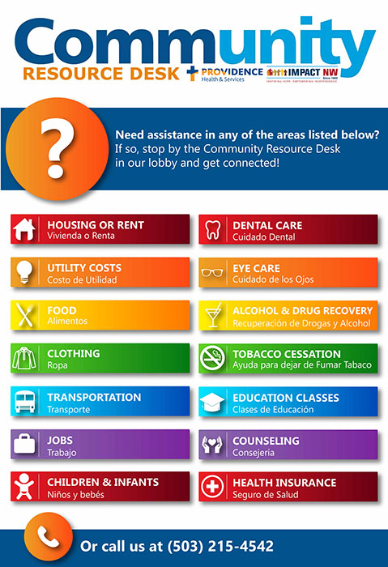
Patient-centered screening
Language barriers
Literacy level
Educational disparities
Comfort level with modality of screening (writing, verbal) and screening environment

Slide 52
Health Literacy
Health literacy is the degree to which an individual has the capacity to:
Obtain, communicate, process, and understand basic health information
Act on information and make appropriate health decisions
Access/navigate the health (and other) systems
Source: Centers for Disease Control and Prevention, PacificSource CCO
Notes:
But essentially, Health Literacy is not just about the ability to read/write or understand communication. This is relevant in all service sectors – not just health care.

Slide 53
Who is impacted?
National Assessment of Adult Literacy (NAAL)
Assessed both reading and math skills
Focused on health-related materials and tasks
36% of adults where identified as having serious limitations in health literacy skills
It is estimated that just 12% of U.S. adults have the level of skills needed to manage the system
Source of slide: PacificSource CCO
Notes:
The 2003 National Assessment of Adult Literacy (NAAL) is the first large-scale national assessment in the United States to contain a component designed specifically to measure health literacy. In 2003, the US Department of Education conducted the first national assessment of health literacy skills in the United States.
Assessed both reading and math skills
Focused on health-related materials and tasks
36% of adults where identified as having serious limitations in health literacy skills.
In this very large, randomized sample of adults aged 16 and over, more than 1/3 of participants were identified as having health literacy skills considered inadequate for managing the demands of the current healthcare system.

Slide 54
Stigma
Stigma associated with poverty, social needs
Sensitive questions (e.g. safety)

Slide 55
Data “Systems”

Slide 56
What are some data systems you could use for SDOH screening & referral?
Paper
Chart flag
Room flag
Stand alone system
Patient portal
EHR integration

Slide 57
Considerations
Time
Cost
Administration modality- (flexibility may be key)
Workflows needs
Ability to share across the community

Slide 58
Partnership Strategies

Slide 59
Partnerships
How do you make yourself aware of available resources?
How do you make referrals?
What is the best way to share information?

Slide 60
Table Activity
For clinical sites: What do you need to better assist patients in obtaining needed social supports?
For community partners: What can clinical partners do to help your clients obtain needed social supports?

Slide 61
Closing Remarks

Slide 62
10 minute break

Slide 63
Developing Sustainable Care Compacts in the Healthcare Neighborhood
Ron Stock, MD MA
March 28, 2019

Slide 64
Notes:
“Clinicians are from Mars, Patients are from Venus”

Slide 65
Learning Objectives
Understand what a care agreement (compact) is, and isn’t
Discuss barriers and facilitators to creating successful care compacts
Discover tools to support successful care compacts
Develop a plan to utilize a care compact

Slide 66
Care Compact/Collaborative Agreements Definition
Care coordination agreement, compact, service level agreement or standardized checklist for referrals all refer to an explicit understanding between providers that outline expectations around defining accountability for care management, the sharing of clinical information, access to care and areas of care coordination to facilitate a well orchestrated and seamless care experience for the patient. A care coordination agreement is not a legal document rather it offers standardized language to describe the referral process and outlines what each provider can provide in key areas.
-Colorado Systems of Care/Patient Centered Medical Home Initiative, funded by the Colorado Health Foundation, 2010. Available: http://www.cms.org/uploads/PCMH-Primary-Care-Specialty-Care-compact-(10-22-10).pdf

Slide 67
Care Compact Components
Sharing data: accurate and up-to-date clinical records
Sharing data: practice-level quality and performance measures
Requirements related to content, timing, and method of communication
Defined responsibilities for patient care and communication throughout the referral process
Defined responsibilities for clinical co-management of specific conditions
Protocols for requesting and conducting referrals

Slide 68
Link to the Triple Aim
Patient Experience: Fragmented care causes delays, miscommunication, gaps in care and, thus, is a major irritant to patients
Cost: Fragmented care leads to unnecessary service especially related to ED and hospital visits
Quality: Lack of a care compact can lead to the lack of coordination across providers on plans of care, which often contradicts and/or misaligns patient goals; this can result in patient safety issue(s)
Notes:
Quadruple aim: staff/clinicians health

Slide 69
Why do “care compacts”?
Patients assume a partnership between the primary care (or mental health) team and specialists;
BH/MH care and Primary care have a robust role in managing the pathway to the system for the patient
Preparing patients—Do they understand why? Do they agree? Are they educated about expectations?
How much time does your practice spend reacting and chasing information rather than being proactive?
P4A
Notes:
A 2009 survey of physicians by the Colorado Medical Society revealed that while a majority of physicians (both primary care and specialty care) ranked care coordination a major area of focus within their practice, only 15% of PCPs and 21% of specialists were satisfied with their communications with other facilities. In addition, physicians noted they always or regularly received necessary information from referrals 41% (PCPs) or 36% (specialists) of the time11.

Slide 70
Historical perspective
The Medical Neighborhood is a systems model that extends the team-­‐based care paradigm and:
Fosters shared accountability among providers
Improves quality
Reduces waste
Aligns incentives to encourage collaboration
Includes measures to evaluate the patients’ experience of care
Real-life examples:
2001, Senior Health & Wellness Center
Notes:
Example:
Johnson Psych Unit and SHWC
Physical Therapist
Home Health Service
Alzheimers Assoc

Slide 71
Partnering Provider's Experience with Care Compacts
Share!

Slide 72
Care Compact Strategy
Develop team and clinical “champion”
Decide who to develop compact with
What is the biggest issue for practices?
Data on population
Validate data and choices
Outreach to the specialty practice/hospital/ community agency
Develop compact
Plan-Do-Study-Act

Slide 73
Exercise 1: Developing the Clinic "Team” and Strategy
Clinician “champion”
The team
How will decisions be made?
Process?

Slide 74
Exercise 2: How do you decide who to develop a compact with?
Seek care compact partners based on need for neighborhood alignment
Decrease unnecessary costs/overutilization
Utilize existing data reports
Partner with those whom communication has been poor in the past
Engage providers and staff
Identify a list of key specialists /PCPs that you want to invite into your medical neighborhood and send invitations to join

Slide 75
Exercise 3: The Compact
Questions to consider:
Think about your various referring partnerships and identify what elements work well for your practice?
Are there areas within your referral relationship that you feel strongly about and/or are non-­‐negotiable as you develop care coordination agreements with your colleagues?
Care compact examples
Colorado Systems of Care/Patient Centered Medical Home Initiative
Available: http://www.cms.org/uploads/PCMH-Primary-Care-Specialty-Care-compact-(10-22-10).pdf
SAMSHA-HRSA
Available: https://www.integration.samhsa.gov/operations-administration/contracts-mous#bmb=1

Slide 76
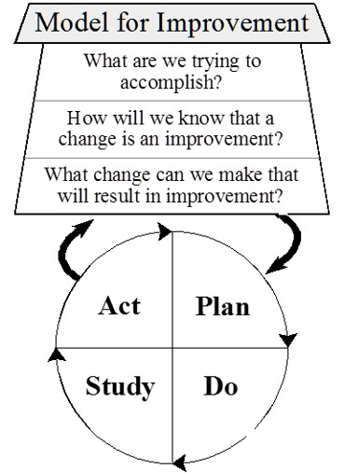
QI Methodology: PDSA (Plan-Do-Study-act)
How will you know whether you’ve accomplished your aim?
Collecting feedback from patients and specialty collaborators
Develop and maintain relationships

Slide 77
Group Q & A

Slide 79
Break for lunch

Slide 80
Tools for Whole Person Care: 42 CFR Part 2 PreManage
Milena Stott, LICSW, CDP

Slide 81
42 CFR: Objectives For Today
Overview of 42 CFR
History and Intent
42 CFR Part 2 in Context of Integration
Regulatory Requirements
Consent / Release of Info
This session does not constitute legal advice. It will provide basic background information to help inform agency protocols and decisions!

Slide 82
Checkpoint #1
Any experts in the room?
Any novices?
Any particular concerns about CFR 42 and whole person care that would be good to discuss and share information about today?

Slide 83
Intent Of 42 CFR Part 2
Protects confidentiality of:
Identity, diagnosis, and prognosis, or
Treatment of any patient records maintained in connection with the performance of any federally assisted program or
Activity relating to substance abuse education, prevention, training, treatment, rehabilitation or research

Slide 84
Why Was 42 CFR Part 2 Enacted? (1/2)
Congress recognized stigma associated with substance use disorders
Fear of prosecution stopped people from entering treatment
42 CFR Part 2 protects individual rights to privacy and confidentiality - a cornerstone of SUD treatment programs for many years
Notes:
For decades, the right to privacy & confidentiality has been In this respect, 42 CFR Part 2 has been in the vanguard of personal privacy protections

Slide 85
Why Was 42 CFR Part 2 Enacted? (2/2)
Prevents misuse of information about an individual’s substance use disorder
Protects individuals seeking and receiving SUD treatment from consequences of a privacy breach
Loss of employment, housing, child custody
Discrimination by healthcare providers and insurers
Arrest, prosecution, and incarceration
Denial of life or disability insurance
Possible impacts on health disparities

Slide 86
What Is A Part 2 Program? Three Definitions
1. Individual or entity
Other than general medical facility
That holds itself out as providing/does provide SUD services & referral
2. An identified unit
Within a general medical facility
That holds itself out as providing/does provide SUD services & referrals
3. Medical personnel or other staff
In a general medical care facility
Whose primary function is:
provision of SUD treatment or referral for treatment and who are identified as such

Slide 87
Examples Of Part 2 Programs
First definition
Freestanding drug/alcohol treatment program
Student assistance program in a school
PCP who provides SUD services as principal practice
Second definition
Detox unit
Inpatient or outpatient drug/alcohol program within a general medical facility
Third definition
Addiction specialist working in primary care

Slide 88
What Does “Holds Itself Out” Mean?
CFR 42 does not define
SAMHSA FAQ examples
Advertising, notices in office
Information given to patients and families
Takeaway: Any activity that would reasonably lead one to conclude SUD services are provided

Slide 89
What Is A “General Medical Facility?”
CFR 42 does not define
SAMHSA FAQ examples:
Hospitals
Trauma Centers
Federally Qualified Health Centers

Slide 90
When Is A Program “Federally Assisted?”
Receives federal funds in any form,
not necessarily for SUD services
Authorized, licensed, certified, registered by the federal government:
IRS tax-exempt status
DEA registration to dispense controlled substances
Receives Medicaid or Medicare reimbursement

Slide 91
Who Is Subject To Part 2? Federally Assisted + Program = Part 2 Program
1. Does the organization receive federal funds in any form or assisted through IRS (tax exempt status)?
No
No, organization is not a Part 2 program
Yes
No
2. Program: Individual or entity other than general medical facility which “holds itself out” as providing and does provide SUD diagnosis, treatment, or referral for treatment?
Yes
Yes, organization is a Part 2 program

Slide 92
42 CFR Part 2 In Whole Person Care
Significant changes in healthcare delivery since Part 2 enacted
Whole person integrated care depends on information sharing on both treatment and care coordination
New IT infrastructures and platforms
New focus on performance measurement

Slide 93
Challenges With 42 CFR Part 2: Possible negative impacts for both provider and patient
Limits on data sharing
Assuming financial risk more challenging
Complicates management of high-risk, high-cost patients
Providers accountable for health outcomes despite missing SUD information

Slide 94
When Is Disclosure Allowed?
Disclosure of information that identifies patient directly or indirectly as having current or past SUD is generally prohibited
Unless patient consents to disclosure through Release of Information (ROI)

Slide 95
Key Point
When dealing with a general medical facility…
The “program” is the unit or medical personnel, NOT the whole general medical facility

Slide 96
Definition Of Program Under Part 2
Case Scenario #1:
Joe Smith enters ED visibly intoxicated following an accident
Dr. Jones calls staff from hospital’s drug/alcohol unit to assess Joe Smith for alcoholism, but he leaves before assessment occurs
Is Dr. Jones a “program” under 42 CFR Part 2?
Notes:
Case Scenario Answer
No, Dr. Smith is not a “program”
Because he works in a general medical facility but not in an identified unit that holds itself out as providing drug/alcohol diagnosis, treatment, or referral for treatment
Dr. Smith would only be a “program” if his “primary function” was the provision of drug/alcohol services (it is not)

Slide 97
Case Scenario #1 Answer
No, Dr. Jones is not a “program.”
Works in a general medical facility but not in an identified unit that holds itself out as providing drug/alcohol diagnosis, treatment, or referral for treatment
“Primary function” is ED provider - not the provision of drug/alcohol services
Notes:
Case Scenario Answer
No, Dr. Smith is not a “program”
Because he works in a general medical facility but not in an identified unit that holds itself out as providing drug/alcohol diagnosis, treatment, or referral for treatment
Dr. Smith would only be a “program” if his “primary function” was the provision of drug/alcohol services (it is not)

Slide 98
Coverage Under 42 CFR Part 2
Case Scenario #2:
Dr. Jones is a PCP in a federally assisted practice
Dr. Jones prescribes buprenorphine for OUD as his primary practice
Is Dr. Jones covered by 42 CFR Part 2?

Slide 99
Case Scenario #2 Answer
Yes, Dr. Jones is a “program” under 42 CFR 2
His principal practice consists of providing drug/alcohol diagnosis, treatment, or referral for treatment
He holds himself out as providing those services

Slide 100
Co-located And Integrated Services: How Do Privacy Laws Apply? (1/2)
Example: “‘Program’ within Larger Entity”
Federally Qualified Health Center
SUD Program
Primary Care
Diabetes Specialist
Mental Health

Slide 101
Co-located And Integrated Services: How Do Privacy Laws Apply? (2/2)
Case Scenario #3:
Quality CHC provides primary care and behavioral health services, including addiction treatment
Providers in some programs within Quality CHC conduct SBIRT
Would Quality CHC be covered by Part 2?

Slide 102
Case Scenario #3 Answer
It depends… on which providers, which units, at Quality are conducting SBIRT
When a unit or provider at the CHC is a Part 2 “program” providing SBIRT, the SBIRT services and all corresponding patient records are covered by Part 2
When a unit/provider at the CHC is not a Part 2 program but conducts SBIRT, the services and records are not covered by Part 2

Slide 103
Co-Located And Integrated Services
How can a Part 2 program share information with co-located or integrated providers?
QSO Agreement (QSOA)
Written Consent

Slide 104
Consent Requirements
Release of information (ROI) must include:
Purpose of release
How much and what kind of information to disclose
Date or condition of expiration
To whom the patient is disclosing information
Can give verbal revocation
Handouts!
Examples from Primary Care and BHA

Slide 105
Checkpoint #2
Any thoughts or comments on these particular ROI examples?
Any better ROI examples that you might share?

Slide 106
When Consent Isn’t Required: Exceptions To Rule Prohibiting Disclosure
Internal communications
Medical emergency
Qualified service organization agreement (QSOA)
No patient-identifying information
Crime on premises/against program personnel
Research (consent through research ROI)
Audit
Court order
Example: Reporting child abuse/neglect

Slide 107
Working With Court-ordered Patients
DOC and CPS – may be afraid to sign ROI
May be ambivalent
Coercive treatment
Shared decision making
MAT and reporting implication
How do we support patients across scenarios with various providers and their training?

Slide 108
SAMHSA Online Resources
Disclosure of Substance Use Disorder Patient Records: Does Part 2 Apply to Me?
https://www.samhsa.gov/sites/default/files/does-part2-apply.pdf
How healthcare providers can determine how Part 2 applies to them
Disclosure of Substance Use Disorder Patient Records: How Do I Exchange Part 2 Data?
https://www.samhsa.gov/sites/default/files/how-do-i-exchange-part2.pdf
How 42 CFR Part 2 applies to the electronic exchange of healthcare records with a Part 2 Program
Substance Abuse Confidentiality Regulations
https://www.samhsa.gov/about-us/who-we-are/laws-regulations/confidentiality-regulations-faqs

Slide 109
Cross Setting Tools: Using PreManage
Milena Stott, LICSW, CDP

Slide 110
Premanage: Objectives For Today
Review basic features and functions
Share BHT provider experience with PreManage
User experience and workflows

Slide 111
Why Talk About This?
Statewide ACH Accountability Metric
All Causes ED Visits per Member Month
BHT P4A Measures
Care Compacts
Referral Pathways & Info Exchange
Complex Care Planning
Workflows and Protocols
(Future) HIE and HIT
MCO Value Based Purchasing
Anticipate P4P Measures

Slide 112
Checkpoint #1
Who is already using PreManage?
Who has a plan to implement?
Hope you’ll all be willing to share good ideas and lessons learned a little later!

Slide 113
Context: Why Talk About This?
Whole person health
Value based purchasing
Accountable care and defined payments
Population health management
Risk stratification
Registries
Treatment to target

Slide 114
Information In PreManage
Admission dx and chief complaint
Demographics
Care team
Disposition
ED visit history
Custom reports on ED utilization
Notes:
Whole person care is really about creating or building primary care capacity for your clients.

Slide 115
Collective Platform
Notes:
Whole person care is really about creating or building primary care capacity for your clients.

Slide 116
Who Can Be On The Network?
Hospitals
Managed care organizations
Providers – BH and primary care
Risk-carrying organizations (ACOs, etc.)
Long term care and post-acute care facilities
Notes:
Whole person care is really about creating or building primary care capacity for your clients.

Slide 117
Passages Experience With EDIE/Premanage
Why we implemented PreManage
How our staff use ED data for our clients
Workflow and follow-up for multiple ED visits
Plan for the future

Slide 118
Checkpoint #2
Would anyone like to share their own experience with PreManage?

Slide 119
Opportunities With PreManage
Real time notification
Allows for rapid response
Providers notified when patients in ED
Full picture of patient’s health and utilization
Patients and clients lost to follow-up
Opportunity to engage or re-engage with new contact information
Opportunity to engage with PCP

Slide 120
Example Of A Rapid Response Strategy
Focus Group: decreasing emergency department utilization management (EDUM) among individuals with medical and behavioral health conditions presenting at EDs. Interventions are specifically aimed to improve rapid engagement in behavioral healthcare post ED-discharge and community stabilization.

Slide 121
Risk Stratification: Matching Service Intensity To Level Of Need
Match client needs to levels of care and types of care
Leverage reports to identify patients with increased risk who may require a higher level of care
Identify patients with co-morbid conditions and/or exceptionally high ED utilization
Care team section
Allows view of all providers and team members involved
Provides two years history of provider information
Can be organized and filtered by status and provider type

Slide 122
Checkpoint #3
Delete if no questions to ask

Slide 123
Online Resources
WA Portal PreManage Toolkit for BHAs
https://waportal.org/resources/premanage-implementation-toolkit-guide-washington-state-behavioral-health-agencies
OR
HealthInsight PreManage ToolKit
https://healthinsight.org/tools-and-resources/send/73-educational-resources/1450-premanage-implementation-toolkit-v2

Slide 124
Checkpoint #4
Final questions, ideas or resources to share around work flow strategies?
Next steps for your organization?

Slide 125
Wrap Up
Thank You!
milenastott@gmail.com

