Slide 1
Value-Based Payment: A Report From the Field

Slide 2
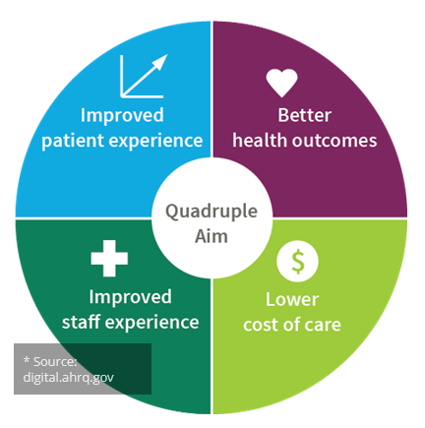
What is Value-Based Payment?
Value-based care is a form of reimbursement that ties payments for care delivery to the quality of care provided and rewards providers for both efficiency and effectiveness.
A healthcare delivery framework that incentivizes providers to focus on the quality of services rendered, as opposed to the quantity.
Under a value-based healthcare model, providers are compensated based upon patient health outcomes.
Notes:
Under the FFS model, healthcare providers are compensated based upon the amount, or quantity, of services delivered.² These services can include office visits, tests, procedures, or other treatments. Reimbursement rates are established for each service clinicians provide. With the FFS model, clinicians are paid for each service individually. Therefore, healthcare providers are, in effect, incentivized to provide a greater number of services per patient.
Value based care – payment algorithm is shifted to tie reimbursement to outcomes – there is a continuum of what this looks like, but it can include accounting for total cost of care outside of just traditionally billable services.
Goals of VBP
Patient-focused – improving not only their health outcomes, but their experience of care as they move through the system.
Improved staff experience – Shifting payment from being so transactional allows providers to be more nimble, innovative and operate in ways that may not be possible within a FFS system. This not only improves staff experience and autonomy, but the patient as well.
Lower costs of care – The goal is to reduce unnecessary spending. When we think of improved outcomes, a lot of focus to date has been on doing things like reducing unnecessary hospitalizations or utilization of ED – outcomes that are costly and are not the ideal experience for individuals. We can begin to move more upstream.
FLAG on unnecessary costs – this needs to be thought of more systematically. In behavioral health in particular, we may see greater costs in outpatient treatment, services – but those are offset by cost savings tied to things like hospitalizations. We can’t look at things in the same silo we used to.

Slide 3
Why Value-Based Payment?
“Business as usual” is not working for the system or individuals.
In 2019, was estimated that only 13 percent of the more than 165 million people needing substance use services received them.
Disproportionate spending for those with co-occurring conditions -- Six percent of individuals with co-morbid behavioral and physical health conditions drove 44 percent of all health care spending.
Many gaps in the system are tied to history of chronic underfunding or siloes: limited workforce, lack of support during transitions of care, gaps in longitudinal care coordination, and appropriate linkage to social supports.
VBP is about improving outcomes and controlling unnecessary or preventable costs – it does not need to mean cutting costs.
Notes:
Looking at this from the BH/SU lens.
Not enough people are accessing services – many reasons for this, particularly around ability to access services
Individuals we often engage with are complex and often disproportionately drive costs across the system – indicates a need to change/adapt
Often times, funding is a primary driver of these gaps.
Effective approaches to engaging and maintaining care of individuals – such as during transitions of care, coordinating care, and effectively linking individuals to social supports are not traditionally billable. This doesn’t mean providers aren’t doing them – many are, but they are doing them at a loss, with constraints.
Workforce – BH chronically underfunded, low wages for hard work means that we have been less able to recruit and retain staff.

Slide 4
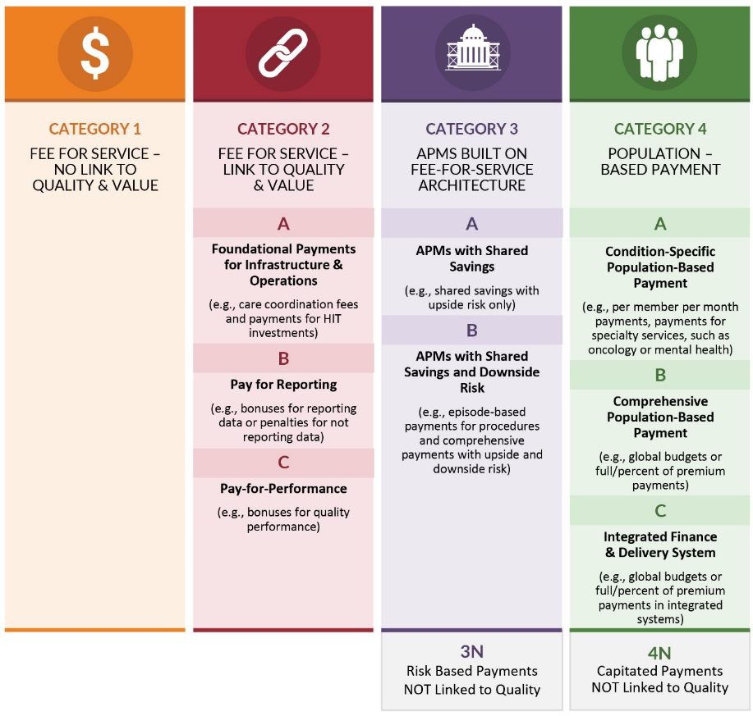
Defining Value-Based Payments HCP-LAN Alternative Payment Model Framework
Notes:
Health Care Payment Learning & Action Network
FFS – Payments made on volume of services, not linked to quality or value
FFS Link to Q&V – Portion of payments may have links to quality and value; for example you get paid FFS but also receive payments for reporting on quality measures or rewards for improved performance on negotiated quality measures (example – initiation and engagement measures, increasing MAT); foundational payments – could be things like covering investments in EHRs, designated payments for covering care coordination staff; may also start to see some “downside” risk in that you could have penalties for not performing on certain quality measures
See these as an on-ramp to more advanced levels of value-based payment
Category 3 – These are often structured as episode-based or bundled payments. Providers are still often paid up front on FFS basis with retrospective reconciliation after the period of performance. Providers have the opportunity to share a portion of the savings when cost and quality targets are met. Can include upside risk only – which means you share in the savings but don’t need to pay back or incur penalties when cost or quality targets aren’t met or up and downside risk – where payers may recoup losses from providers when targets aren’t met.
Ex: Value in Opioid Treatment Demo from CMMI - participating providers receive a per-member, per-month (PMPM) care management fee and
are eligible for performance-based incentives payable based on participant’s performance with respect to criteria specified by CMS
Population-Based Payments
There are levels of alternative payment models.
For many, there is/will be an “on ramp” in moving towards more risk-based models
This is not one size fits all – some may never move past category 2, some may engage indirect contracting – perhaps a hospital system is engaging in category 4 and wants to offer you rewards for performance for their patients with SU needs

Slide 5
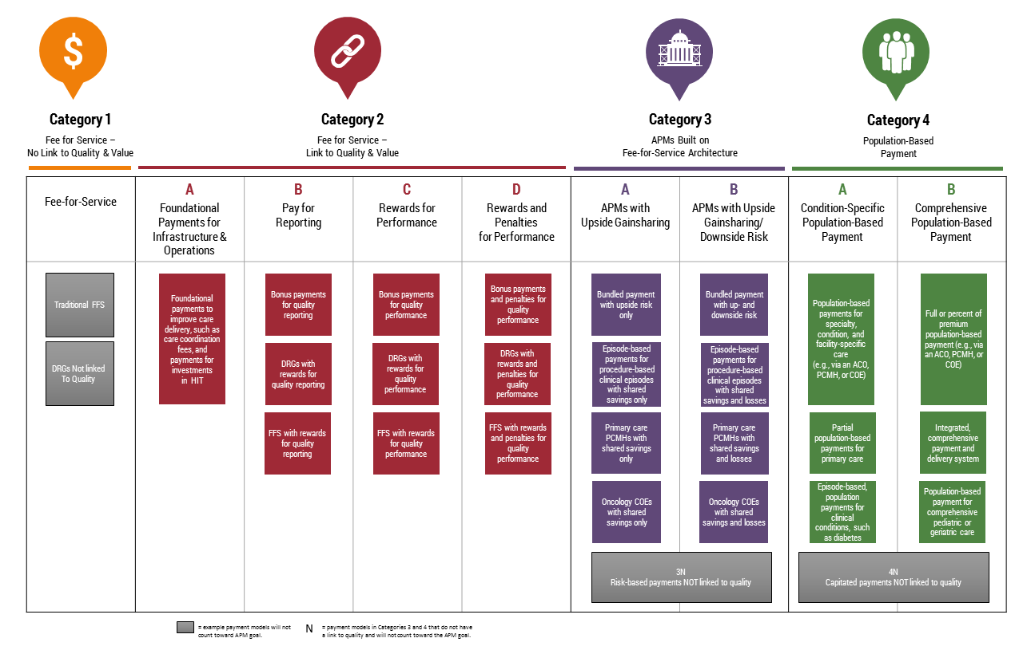
Category Details

Slide 6
Contracting Continuum
Not one size fits all!
Direct contracting (think “lead VBP contractor”)
Directly contracting with a payer for a value-based contract. Lead contractors could be individual providers or groups of providers (such as independent practice associations, ACOs).
Indirect contracting (think: “provider partners”)
Contracting with an entity that is contracting with a payer for a value-based contract. As a partner, potential opportunities to benefit from alternative payment approaches in exchange for providing services that drive outcomes.
or
Notes:
Lead VBP contractor or provider partner
VBP “Contractors” could be: • Entity who contracts with Managed Care Organizations (MCO) • Accountable Care Organizations (ACO) • Independent Practice Association (IPA) • Individual Provider
Indirect Contracting but Direct Quality Impact

Slide 7
National Trends: Medicaid
HCP-LAN goals include having half of Medicaid and commercial plan payments and all of Medicare payments be value-based by 2025.
Growth and expansion of managed care: In 2019, 37 states had the majority of their population enrolled in managed care, compared to 2010 when only 25 states had the majority of their population enrolled in managed care.
In 2019, $299 billion—over half of the total Medicaid spending — was for managed care capitation and premium assistance payments.
Approximately 93% of Medicaid managed care organization (MCO) plans reported using VBP or alternative payment models (APMs) during 2019. About 79% of the plans reported that their state contracts required them to implement VBP contracting with provider organizations.
https://openminds.com/market-intelligence/executive-briefings/medicaid-health-plans-vbr-pick-up-steam/

Slide 8
National Trends: Medicaid
Medicaid health plans are changing how they reimburse provider organizations for services.
28 state Medicaid plans require their health plan contractors to reimburse provider organizations using APMs.
The Institute for Medicaid Innovation reported that all Medicaid MCOs covering more than 250,000 consumers reported using VBPs or APMs; about 80% of MCOs with up to 250,000 consumers also used VBPs and APMs.
The most common payment strategies:
Payment incentives based on access to care (about 64%)
Incentives for availability of same-day or after-hours appointments (43%)
Enhanced payment rates for hard-to-recruit provider types (29%)
Other strategies (29%) including the integration of behavioral health care into primary care
https://openminds.com/market-intelligence/executive-briefings/medicaid-health-plans-vbr-pick-up-steam/

Slide 9
COVID Implications for VBP
Organizations engaged in alternative payment generally reported having more financial protection against FFS downturns during the pandemic, since their payments were less affected by declines in service volume.
VBP model flexibility allowed practices to pivot quickly to develop and sustain effective care models during the public health emergency, regardless of whether the services or activities are reimbursed (or not) under a fee-for-service system.
Organizations engaged in VBP reported having developed a wide range of capabilities which were critical for effective COVID-19 responses, such as:
Dedicated staff and workflows to support care coordination and information sharing across providers and settings
Robust data infrastructures enabling population health management
Established telehealth platforms capable of handling quick shifts to virtual care delivery and management.
https://healthpolicy.duke.edu/sites/default/files/2020-07/best_practices_brief_final.pdf

Slide 10
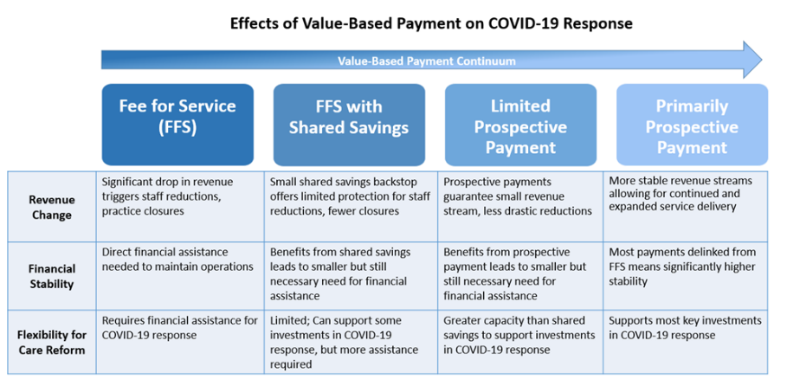
COVID Implications for VBP
https://healthpolicy.duke.edu/sites/default/files/2020-07/best_practices_brief_final.pdf

Slide 11
Competencies for Value-Based Care

Slide 12
Value-Based Payment Preparedness True North: Quadruple Aim
Notes:
The quadruple aim reminds us of the delicate balancing act we’re trying to achieve. We all know the healthcare system in terms of costs and outcomes needs improvement, and we’re doing so by adding value into the equation. So we’re looking to achieve within the system:
Better outcomes: Data showing that the persons we serve are getting better, data showing that our organizations are thriving
Improved patient experience: With better outcomes, the patient experience is elevated, but we also are striving for a system that includes treatment of the whole person, access to care, participation in their own treatment planning, and education about their treatment and diagnoses
Lower costs – the idea is that with better outcomes, costs will lower because persons are getting better and are not going in and out of expensive interventions. This could look like many different things for many different organizations…for example, you could be providing a more costly evidence-based service up front, but at the same time keeping persons from inpatient readmissions, so ultimately saving costs
Finally, some genius realized that we can’t be successful in this wheel of value without considering our clinican experience because it’s their work and sweat and tears that drive this process. Of course we’re here for the persons we serve and better outcomes will make us happer, but we also want a system that makes the lives of our clinicians easier, more efficient operations, more data to show the good work they’re doing, cultivating joy in the workplace, and ensuring specificity in roles
So, this is what we’re tyrying to achieve

Slide 13
Readiness for Value-Based Payment
Set Aims
Use Data to Drive Care
Achieve Progress on Aims
Benchmark Status
Thrive as a Business through VBP Systems

Slide 14
What You Need
Clinical
Operational
Financial
Notes:
How do we get there at the individual organization level? WE have a lot of work to do, but everyone here is already on the right path.
I’m going to overwhelm you for a second by listing some competencies we look for in the value-based world……

Slide 15
Clinical
Population Health Management
Risk Stratification
Care Pathways
Team-Based Care
Coordinated Care
Patient Engagement
Evidence-Based Care
Access to Care
Notes:
Population Health management – Looking at your community and your client population and understanding their needs (social determinants, settings, poverty level, etc.)
Risk stratification – looking at those within your population that are highest risk for negative outcomes and costly repetitive interventions.
Care Pathways – designing workflows that encompass the evidence-based services, touchpoints, referrals, and education a clinet at higher risk should receive and continuously quliayt checking the data
Coordinated Care
Patient engagement
Evidence-based care
And, of course, access to care…how are we moving the needle on access issues without our communitues?

Slide 16
Operational
Data to Inform Decision Making
Continuous Quality Improvement
Transparent Measurement and Monitoring
Optimal Use of Technology/Interoperability
Notes:
Operatoinally speaking:
Data – how do we get data necessary to measure the success of what we’re trying to accomplish. How do we leverage our current data?
CQI – How do we foster a culture of quality improvement within our organizations and ensure that we’re consistently revisiting workflows, policies, metrics, etc. to ensure we’re delivering on the quadruple aim
Transparent Measuring – are we communicating how we measure success to our staff members and clients?
Technology – is our technology working for us….can it make our lives easier/more efficient…can it save costs.

Slide 17
Financial
Revenue Cycle Management
Return on Investment
Costing through Data Integration
Relationship with Payers
Sustainable Contracting
Notes:
Revenue Cycle – do you have knowledge of your revenue cycle to the extent that you can make financial decisions within the value-based world?
Are you considering ROI when you look at new investments and opportunities for your organization?
Do you understand how much your services cost so that you can participate in sustainable contracting and ensure your contracts help your business in the value-based world?

Slide 18
Value-based Care: Developing Your Value Proposition

Slide 19
Stepwise Process for Crafting Your Value Proposition
Step 1: Understand What is Meant by “Value Proposition”
Step 2: Conduct a Stakeholder Analysis to Understand Who Your Value Proposition is For
Step 3: Identify and Collect What Data You Will Need to Build Your Value Proposition
Step 4: Craft Your Actual Value Proposition
Step 5: Develop Your Communications Strategy for Your Value Proposition
Step 6: Enhance Your Value Proposition Through Partnerships as Needed
Step 7: Update and Tailor Your Value Proposition

Slide 20
What is a Value Proposition?
Explains what benefit your organization provides, for whom, and how you do it successfully.
Builds the case for why you are uniquely positioned to meet the community’s need.
A living document that can be updated as needed and is tailored to different audiences.

Slide 21
Step 2: Stakeholder Analysis
Who do you need to influence, and what do they care most about?
Policy makers
State and County Administrators
Managed Care Organizations
Commercial payers
Potential clients
Accountable Care Organizations
Independent Provider Associations
Other current or potential partners
Notes:
POLICYMAKERS: How do your services help improve the health and well-being of the community members represented by policymakers and how do they reflect their legislative priorities?
STATE AND COUNTY ADMINISTRATORS: How do your services help the state or county reach its intended goals and obligations to the Centers for Medicare and Medicaid Services (CMS), the state legislature and the public.
MANAGED CARE ORGANIZATION (MCO) OR HEALTH PLAN CONTRACT STAFF: How do your services help the health plan reach its obligations to the state and its organizational goals? To what measures does the state hold providers ac- countable? For what are they held accountable? What are the state’s expectations of providers?
ACCOUNTABLE CARE ORGANIZATIONS (ACOS): How do your services augment those of other providers within the ACO and help the ACO meet its contractual obligations or value-based payment goals?
OTHER CURRENT OR POTENTIAL PARTNERS: How do your services align or supplement those of large health systems or community-based organizations? For example, potential primary care partners may be held accountable for reducing hospitalization and improving health outcomes for patients with chronic disease. Your value proposition may be focused on the role behavioral health can play in co-management of chronic disease among shared patients.

Slide 22
Example: The Center for Behavioral Health
The “Center for Behavioral Health” sees 10,000 clients annually, and 85% have Medicaid.
The State contracts with Managed Care Organizations and provides much flexibility.
XYZ Health Group is the largest Medicaid Managed Care Organization in the region.
Conclusion: XYZ Health Group is the most important partner to influence if CBH wants to pursue a value-based contract.

Slide 23
CBH Sample Stakeholder Analysis
What do they care about most?
Like all MCOs, XYZ Health Group is interested in market share.
XYZ Health Group is committed to reducing the total cost of care through appropriate utilization patterns.
XYZ Health Group has been piloting value-based payment models including pay-for-performance, bundled payments and shared savings.
They like predictability and appreciate when providers know the utilization patters, morbidity rates and demographics of their clients.
How does CBH know all of this? Intelligence gathered from the MCO procurement process, literature review, stakeholder meetings, and previous contracting meetings.

Slide 24
Step 3: Identify and Collect Data
Taking what you learned from the stakeholder analysis, begin compiling the data that will be most compelling to your audience.
This may include:
Reductions in emergency department utilization, hospitalization and/or hospital readmission
Access data (e.g., how quickly patients get seen from time of referral)
Physical and behavioral health outcomes
Patient satisfaction
Cost data

Slide 25
Example: CBH’s Data Collection Plan
Data that demonstrates success in reaching clients within 7 days post-hospitalization. Source(s): regional health information exchange, claims data, EHR
Data that demonstrates client satisfaction and perception of impact. (client success stories). Source: Care Coordinator collecting anecdotes from clients.
Data that demonstrates market penetration (alignment with XYZ’s client base). Source(s): HER
CBH cost data. Source: claims management system, program budget.

Slide 26
Step 4: Craft Your Actual Value Proposition
Key Elements:
WHAT community need do you address?
WHOM do you serve?
HOW do you meet the community’s needs?
WHY are you better than your competitors?
Strong value propositions are relevant, specific, and CREDIBLE.

Slide 27
Example: CBH’s Value Proposition Elements
What community need do you address?
Whom do you serve?
How do you meet the community’s needs?
Community members with behavioral health disorders lack access to appropriate services. Some are using the hospital as their primary source of care, and their post-discharge care is not being well coordinated.
CBH serves adults with serious mental illness and/or substance use disorders. Many also have co-morbid chronic health conditions. 79% of CBH’s clients have coverage through XYZ Health Group.
Licensed clinicians provide an array of psychiatric and counseling services using validated screening tools and evidence-based treatment. CBH has a new follow up care program targeting clients with serious mental illness who have been hospitalized for psychiatric reasons.
Why are you better than your competitors?
CBH is outcomes-oriented and has strong data analytics capabilities. We have data that show we can get clients seen within 7 days post-hospitalization at a higher rate than the MCO average. We are efficient and keep overhead costs low.

Slide 28
Step 5: Develop Your Communications Strategy
Think of how you will communicate your value proposition. What will be most effective for your audience?
Share quantitative data through charts, graphs, or other visual representations.
Share patient stories that demonstrate your success!
Incorporate your value proposition into:
Presentations
Collateral materials such as fact sheets, newsletters, brochures
Formal written proposals

Slide 29
Example: CBH’s Communication Strategy
CBH’s contract as part of the XYZ Health Plan Network is up for renewal in 3 months.
CBH determined the best strategy for communicating their value proposition would be to develop a white paper and also request to do a formal presentation at a contract negotiation meeting.
CBH incorporated the quantitative data they had collected and the most compelling patient story they had collected.

Slide 30
Tips for Successful Contract Negotiations
Know
when your contracts can be renewed or renegotiated.
Understand
what is important to the payer per your stakeholder analysis.
Look
for the win-win.
Bring
the right people to the room.
Prepare
to share your value proposition and all relevant data.
Remember
organizations are run by people. Meetings are about building a personal relationship.
Know
your costs.

Slide 31
Step 6: Enhance Your Value Proposition Through Partnerships
Partnerships can enhance your value proposition by expanding your scope of services, reaching a larger patient population or bringing in additional capacity and core competencies.
If you decide to partner, ensure you share a common vision, clearly defined roles, agreements in writing, and aligned value propositions.
Notes:
Get the “right fit”
Ensure you have a common vision
Define your respective roles and responsibilities
Solidify your agreements in writing
Collaborate to develop consistent messaging and align your value propositions

Slide 32
Example: CBH’s Partnership Strategy
CBH determined it would be more effective in reaching clients within 7 days post hospitalization by formalizing their partnership with the local hospital.
They created a Memorandum of Understanding and written protocol for information exchange.
CBH decided it would be strategic to invite the hospital to their upcoming contract negotiation meeting with XYZ Health Plan.

Slide 33
Step 7: Update and Tailor Your Value Proposition
Determine a process for reviewing and updating your value proposition based on emerging needs, new partnerships, current data and/or accomplishments, significant changes within your organization, changes to your costs or within your external health care environment.
Identify the person(s) or team who will be responsible for updating your value proposition, how often it will be reviewed and updated and how you will engage leadership and staff in this process.
Update your value proposition in accordance with your process.

Slide 34
The Case for Value-Based Payment for Substance Use Disorder Treatment and Recovery Services
The COVID-19 pandemic has exacerbated the challenges of the substance use crisis and revealed longstanding gaps in access to quality care.
Drug overdose deaths rose by over 30 percent between 2020 and 2021.
Data has indicated that behavioral health needs have increased during the pandemic while utilization of services has not risen enough to meet these additional demands.
Value-based payment as a tool to incentivize high-quality, coordinated care that can support continued disease management.
Individuals with SUD often have complex psychosocial needs that may require varying levels of treatment and other supports.
Comprehensive or “team-based” care delivery models can support coordination across these services; facilitate improved delivery of evidence-based practices and connect individuals to the appropriate level of care through the recovery process.
Notes:
Value-based payment can be a critical tool to incentivize high-quality, coordinated care that can support continued disease management.
Individuals with SUD often have complex psychosocial needs that may require varying levels of inpatient or residential treatment, outpatient medication management, cognitive behavioral therapy or other counseling, peer supports, or other wrap-around social supports.
Comprehensive or “team-based” care delivery models can support coordination across these services; facilitate improved delivery of evidence-based practices, such as Medication for Opioid Use Disorder (MOUD); and connect individuals to the appropriate level of care through the recovery process.
Given the impact of unmanaged SUD in driving overall health care costs, VBP approaches and accountability for outcomes may help address critical gaps in current treatment systems, including a limited workforce, lack of support as patients transition between levels of care, gaps in longitudinal care coordination, and appropriate linkage to social supports.

Slide 35
Existing Alternative Payment Models for SUD/OUD
Model | Overview
Patient-Centered Opioid Addiction Treatment (P-COAT) | Designed to support team-based Office-Based Opioid Treatment. Opioid Addiction Treatment Teams receive risk-adjusted payments for initiation of treatment (evaluation, diagnosis, and treatment planning), as well as an ongoing monthly payment to provide or coordinate medication, psychological treatment, or social services. Performance measures include: Percentage of patients who filled prescribed medications; demonstrated compliance with treatment plans; demonstrated compliance with drug-testing programs; number of opioid-related ED visits.
Addiction Recovery Medical Home APM (AMRH-APM) | AMRH-APM applies a chronic disease management model, over a five-year period, to support patients through long-term recovery management. Although the model is intended to be flexible, key elements include individualized treatment and recovery plans, care recovery teams, payment tied to patient outcomes, and potential shared savings from coordinating patient care across health services. The model is currently in pilot development in local commercial and Medicaid markets, and in a statewide Medicaid exploration effort.
CMMI “Value In Treatment” Demonstration | 4-year demonstration program intended to increase access to OUD treatment services for the Medicare FFS population, improve physical and mental health outcomes, and reduce health care costs for individuals with OUD. As part of the demonstration, participating providers will receive a per-member, per-month (PMPM) care management fee and will be eligible for performance-based incentives payable based on participant’s performance with respect to criteria specified by CMS (e.g., evidence-based medication-assisted treatment (MAT) and patient engagement and retention in treatment).

