Slide 1
Leadership Council
March 23 ,2016

Slide 2
OUR CHARGE:
To radically improve the
health of our region

Slide 3
Introductions & Big Wins

Slide 4
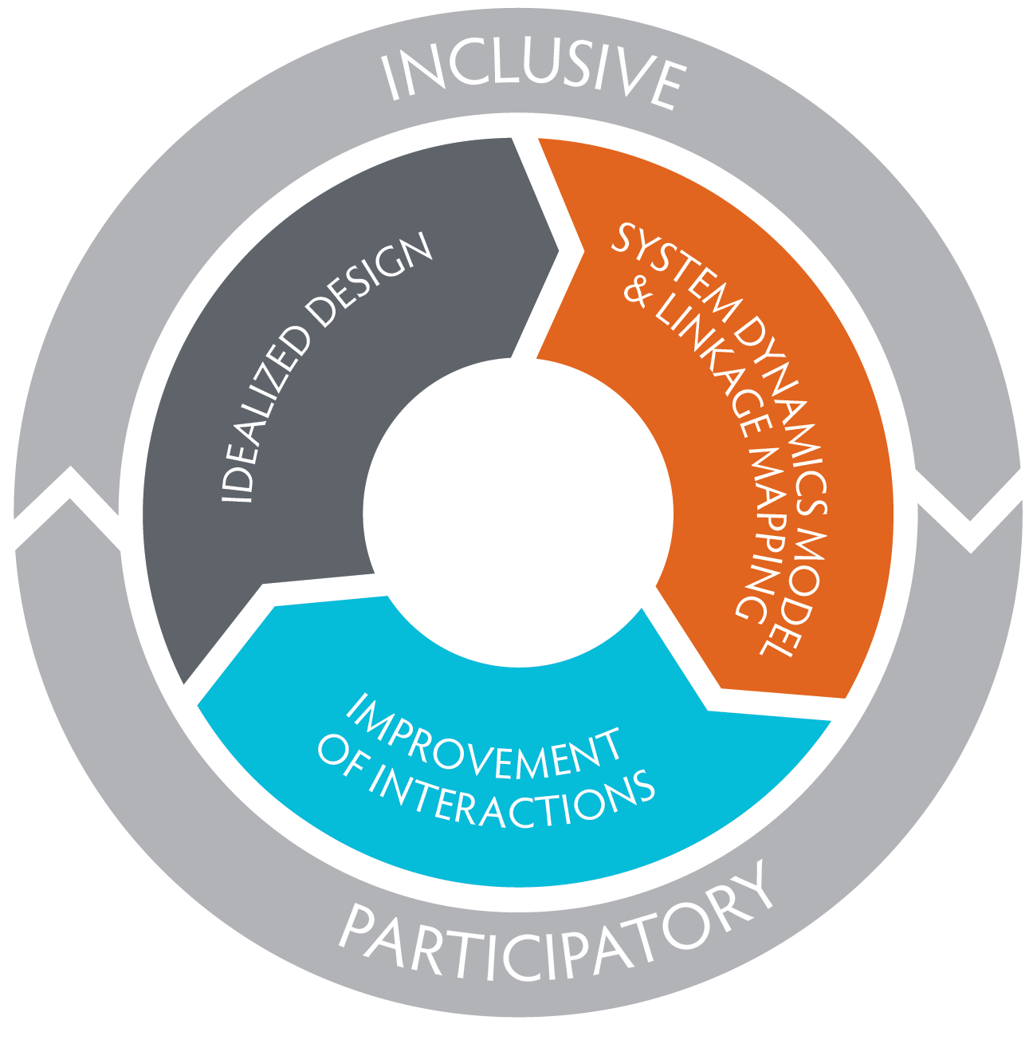
ACH Development
Idealized Design – define the system we wish we had
Create Linkage maps of the interactions to see the whole system works together
Assess what needs to be added, scaled and aligned utilizing the Rippel Model to see short, mid and long term effects of interventions on improved health and savings
Select 1-3 Regional Priority projects that will leverage new funding to the region and demonstrate multi sector alignment of activities
Develop Regional Health Improvement Plan based on Linkage Maps and Idealized Design

Slide 5
2016 ACH Deliverables
Approve an ACH Regional Health Inventory (Community Linkage Maps)
Approve an ACH Regional Health Improvement Plan (Community Strategy Maps)
1 Regional Project
AND be ready for,
Coordinating Entity if Medicaid 1115 waiver comes through
Serve as a hub for SIM Department of Health Practice Transformation work
Serve as a “monitor/supporter” of Health Outcomes for the region, engage on Performance Measures from the Starter Set
Serve as a local activator for Plan for Population Health

Slide 6
And then,
April
May
June
Presentation of Strategy Maps
Develop Regional Project Framework and criteria
Discussion on Regional Project selection criteria
March
Synthesizing of Idealized design into Strategy Maps by Priority area
Synthesizing of Community Linkage Mapping, identify key elements that are missing
Presentation of Draft Care Coordination Strategy Map
Board approval of Regional Health Improvement Plan
Board approval of Project selection criteria
Presentation on Regional Project Framework based on Strategy Map
Outreach to key stakeholders for feedback of Strategy Map and Community Linkages
July
Board approval of ACH Region Project Selection
Develop a consumer engagement feedback mechanism for review of Strategy Map
Presentation of Community Linkage Maps
Project Launches!

Slide 7
On the Horizons
Practice Transformation
Practice Transformation Hub TBD Fall ‘16
Pediatric Transformation Clinical Integration Grant
Medicaid Waiver
Decision in April
Transformation through Accountable Communities of Health
Plan for Population Health
Released in Fall ’16
BHO/Full Integration
DOH 1422 Clinical Linkages with CHW/
CMMI Grant Accountable Health Grants
Service Options that allow older adults to stay at home and delay or avoid the need for more intensive services
Targeted Foundational Supports
BHO Integration in our region on 4/2016
Mid Adopter Option LOI on 5/2016
Full Integration by 2020
Initial focus: Healthy Eating, Active Living, Tobacco Free and Obesity Prevention
Initial focus: Mental health, substance use (opioids)
Initial focus: Trauma Informed practices (ACES)
Performance Measures
Performance Measures Coordinating Committee
(reported/analyzed by Washington Health Alliance)
AIM
Paying for Value
Payment Model 1: Early Adopter of Full Integration
Payment Model 2: Encounter Based to Value Based
Payment Model 4: Greater Washington Multi Payer Model
Payment Model 3: Accountable Care Programs and Multi Purchaser
Initial focus: Cardiovascular Disease and Diabetes

Slide 8
ACH Priority
Scaling Community Based
Care Coordination

Slide 9
ACH Priority: Scale Community Based Care Coordination
Vision
Goals
Objectives
Strategies and Actions
The health of our community members are improved by a Network of Care Coordinators that serves as a single point of access enabling efficient and effective use of community resources, ability to identify and track risk, and measure outcomes.
An informed, well-trained, culturally competent network of care coordinators is available to rural and urban community members 24/7.
Develop and implement a BHT ACH regionally scalable community based network of best practices for Care Coordination that reflects a model to support rural and urban populations.
Recruit, train and develop a community based network of culturally competent Care Coordinators.
Every person in our community has whole-person-centered care.
People can easily access information and connect to the care and services they need to support their health and well-being across their life continuum and circumstances.
Align existing care and service providers on Community based care Coordination Model and related whole-person health and wellbeing models.
Design and implement a communications strategy to inform clients and community members of care coordination services.
Establish and adopt a standard health/risk assessment and intake process that aligns with current practices (health homes) and/or other
An integrated technology platform is available to all Care Coordinators, providers, agencies and individuals to provide planning and real-time support for health and well-being.
The care coordination integrated technology platform provides and allows input of patient information and wellness plans; flags risk; and offers dashboard and detailed views for patients, care coordinators and providers.
Identify and adapt (or design) client-facing care coordinator processes and tools.
Establish internal tracking and support systems and measures to support and guide ongoing support and improvement for the network of care coordinators.
Develop a centralized system of community resources based on location and needs served. (211 to scale or other)
Review and select from available customizable ”off the shelf” secure informational platforms that allow real-time universal access to and input of PHI within the health coordination team and with the patient. [TwineHealth]
The care coordination network provides solid data, measures and trends for evidence-based decisions, planning and investment.
Community, business and health system leaders work together to continually improve linkages between organizations and agencies where health is affected.
Establish and implement measures related to health impact, efficiency, effectiveness and costs.
Accelerate payment models to incent value based purchasing
Leaders are committed and engaged in collaborations to improve how people receive care and services.
Establish a shared savings model for local reinvestment.
Identify potential partnerships across providers, agencies and organizations to engage regularly in agreeing on steps to improve connections and coordination.

Slide 10
Pathways: A Community HUB Model

Slide 11
Background
HealthMatters of CO
One of the original 12 care coordination BETA sites in the country under AHRQ, Innovations Exchange
Participated in developing the AHRQ Community HUB manual
Supported the integration of care coordination throughout region
Built robust network for multi sector stakeholders and providers
Agency for Healthcare Research and Quality - Innovations Exchange
Quickstart Guide – Community HUB
Rockville Institute – Research for the Advancement of Social Science
National Pathways Certification HUB
CHAP – Pathways Model

Slide 12
Connecting Those at Risk to Care
Source: AHRQ Publication No. 15(16)-0070-1-EF January 2016

Slide 13
Pathways Community HUB Model
Build regional community capacity through an accountable regional infrastructure that improves health outcomes and reduces costs by connecting those at-risk to quality community based care coordination
No wrong front door - “Air traffic control”
Monitors the quality, effectiveness and efficiency of community care coordination, focusing on team approach to sustain care coordination with emphasis on health not just healthcare
Supplement and support, not replace, existing case managers, nurses, social workers, community health workers, care coordinators, etc. partnering with multi-sector community stakeholders
Supports the linkages of payments to health status improvements and outcomes
Promotes community participation in health promotion and disease prevention activities – up stream

Slide 14
How would it work?
Find:
Identify those at risk
Connect:
Ensure that individual are referred and receives needed evidence-based health and social services
(e.g., prenatal care, immunizations, housing, chronic disease, parenting education, food, clothing, and many more)
Measure:
Document and evaluate benchmarks and final outcomes

Slide 15
Pathways Protcols
A Pathway is a standardized process that identifies, defines, and resolves an at-risk individual’s needs
Each Pathway represents one issue that is tracked through to completion and a measurable outcome
Follow standardized protocols to conduct individualized comprehensive assessment (consistent with National Quality Forum (NQF) guidelines of care coordination) and problem-solving to help individuals
Protocols help navigate the fragmented health and social service systems by supporting the identification and elimination of barriers
Protocols address and strive to minimize disparities that exist for community
Notes:
Linkage and referrals of individuals with demonstrated need of connection to services that are beyond the scope of the referring agency are made by organizations/agencies across the county
Upon receipt of the referral, team conducts a Health Risk Assessment (HRA) of the case and assigns the community member/family to a CHW matching the needs with CHW experience and special skills, e.g., bilingual, culturally competent, etc. when indicated
The HRA is utilized by the CHW to assign protocols (pathways) to the client and then continues with follow up processes until completion

Slide 16
Pathways Protcols
Behavioral Health
Child Care
Child Support
Dental
Depression
Diabetes
Domestic Violence
Education/GED
Employment
Food Security
Heat & Utilities
Health Care Home
Homelessness Prevention
Housing
Income Support
Legal Services
Medical Debt
Pharmacy/Medications
Pregnancy
Substance Use/Abuse
Transportation
Vision & Hearing
Notes:
Linkage and referrals of individuals with demonstrated need of connection to services that are beyond the scope of the referring agency are made by organizations/agencies across the county
Upon receipt of the referral, team conducts a Health Risk Assessment (HRA) of the case and assigns the community member/family to a CHW matching the needs with CHW experience and special skills, e.g., bilingual, culturally competent, etc. when indicated
The HRA is utilized by the CHW to assign protocols (pathways) to the client and then continues with follow up processes until completion

Slide 17
SNAP Presentation

